Slide 2
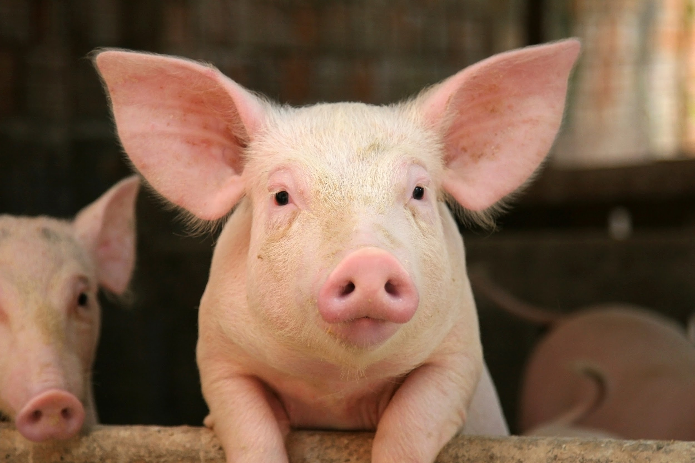
Swine Breeds

Slide 3
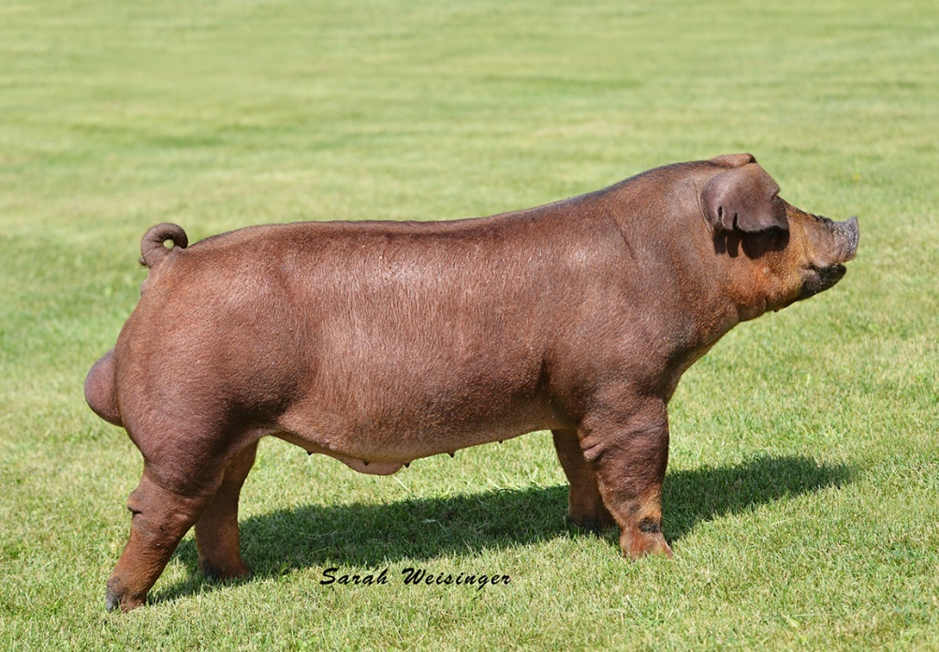
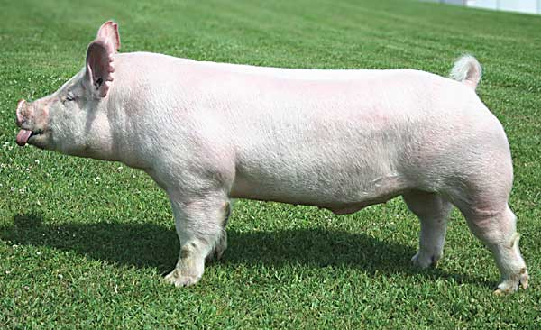
Swine Breeds
There are two easy ways to distinguish between swine breeds:
Dam breeds (white) vs. Sire breeds (colored)
Erect ears vs. down ears
With hogs, “shire” in the breed name means that the ears will be erect, so you can assume that all breeds that end in “shire” will have erect ears

Slide 4
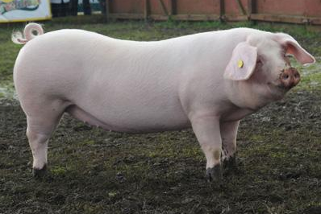
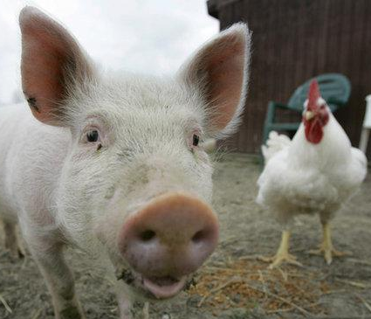
Dam Breeds (white):
These breeds all have white hair and pink skin
Often harder to distinguish between than the colored breeds
Breeds that you will need to know:
American Landrace
Chester White
Yorkshire

Slide 5
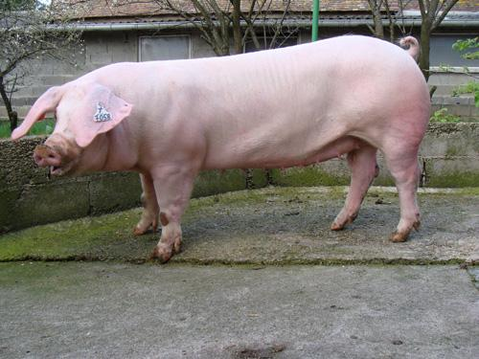
American Landrace

Slide 6
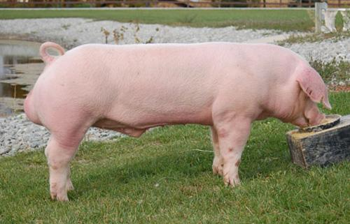
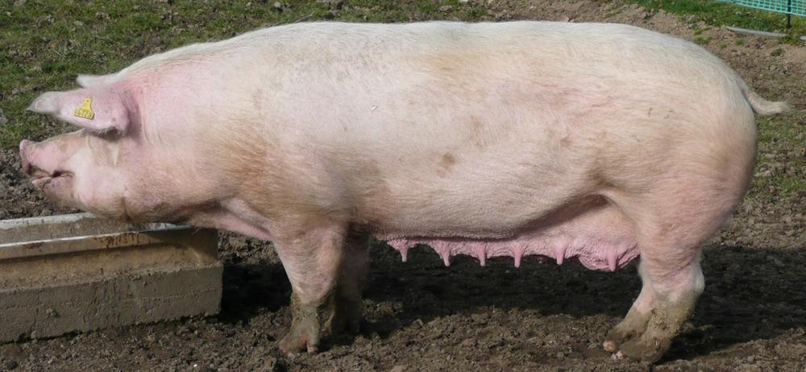
American Landrace (USA)
Large breed with long bodies
White color
Large droopy ears that run parallel to head (bigger than Chester White)

Slide 7
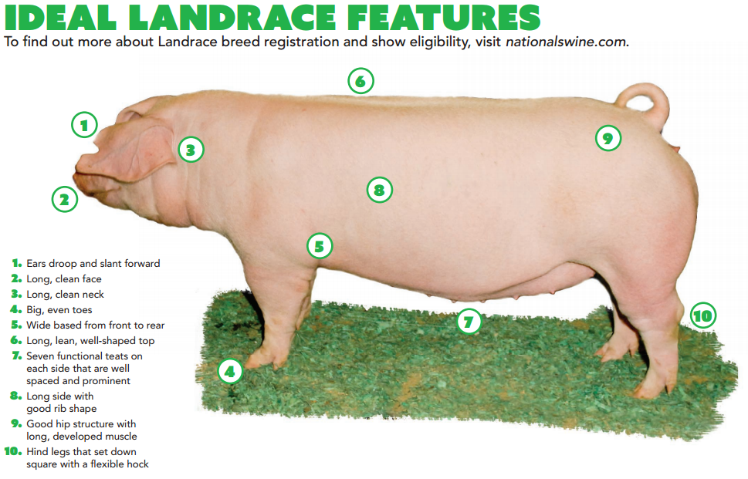

Slide 8
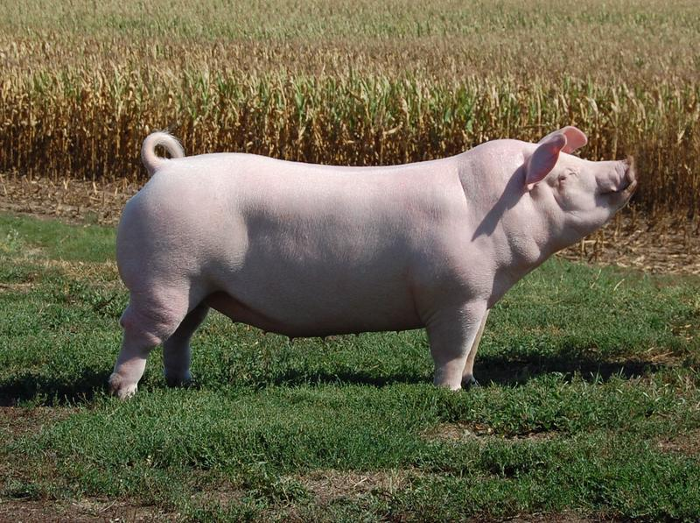
Chester White

Slide 9
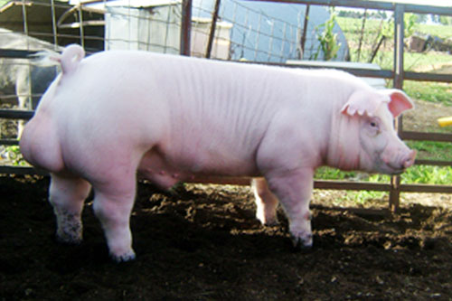
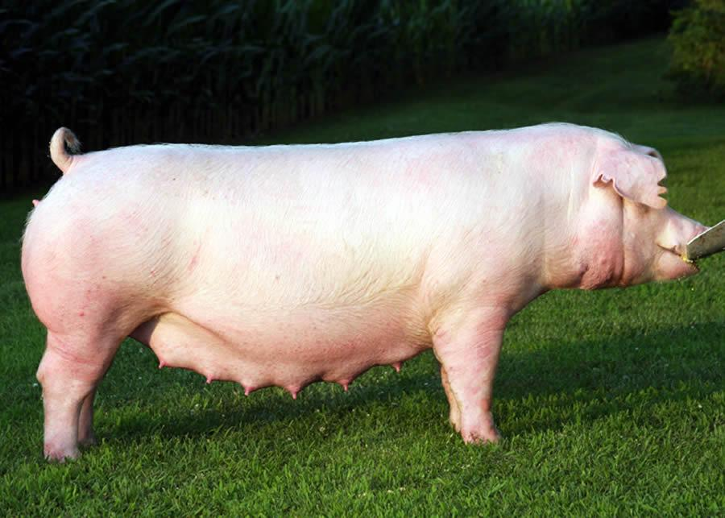
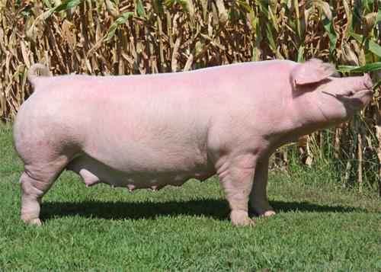
Chester White (USA)
Medium/Large breed
White color
Droopy ears (smaller than Landrace)
Large liter sizes

Slide 10
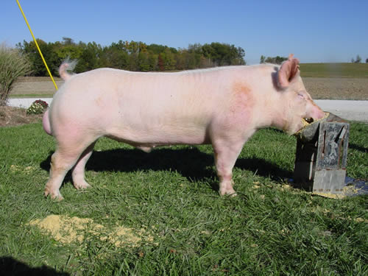
Yorkshire

Slide 11
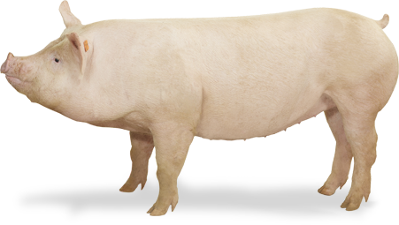
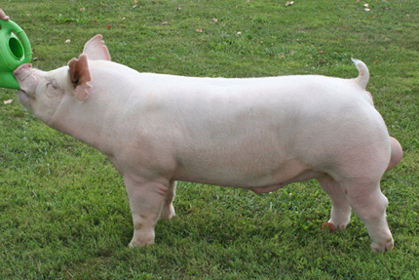
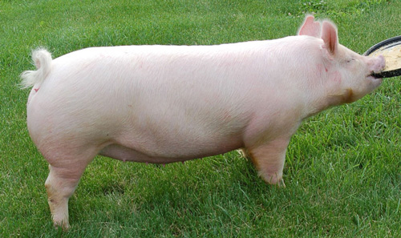
Yorkshire (England)
AKA “Large White”
Large/very large breed
White color
Erect ears
Called the “mother breed”
Large litters and lean carcass

Slide 12
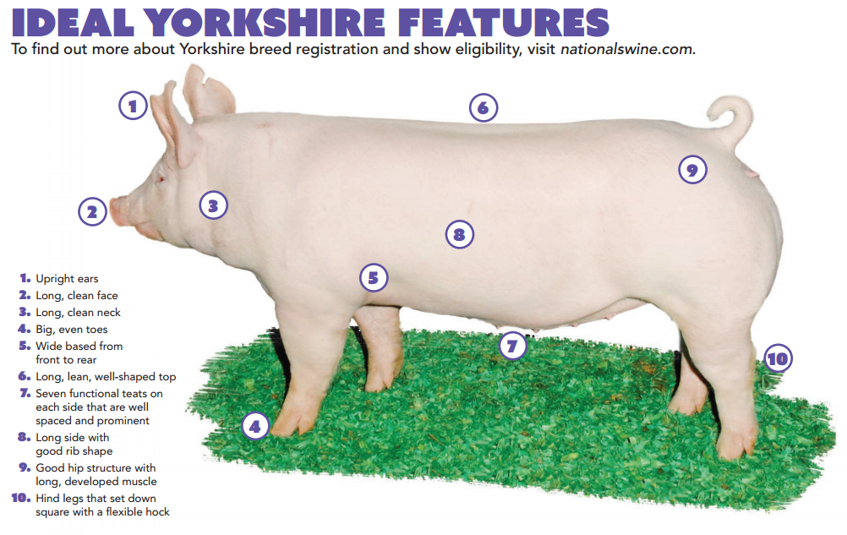

Slide 13
What breed is Babe?
Answer: Yorkshire

Slide 14
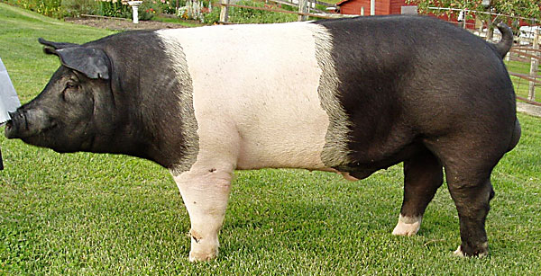
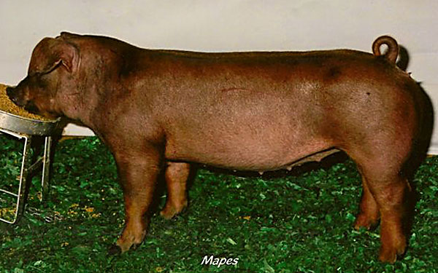
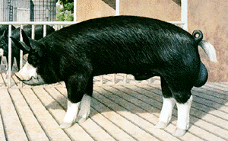
Sire Breeds:
These breeds have large sections of dark pigmented skin and a majority of the hair with colors other than white
Breeds that you will need to know:
Berkshire
Duroc
Hampshire

Slide 15
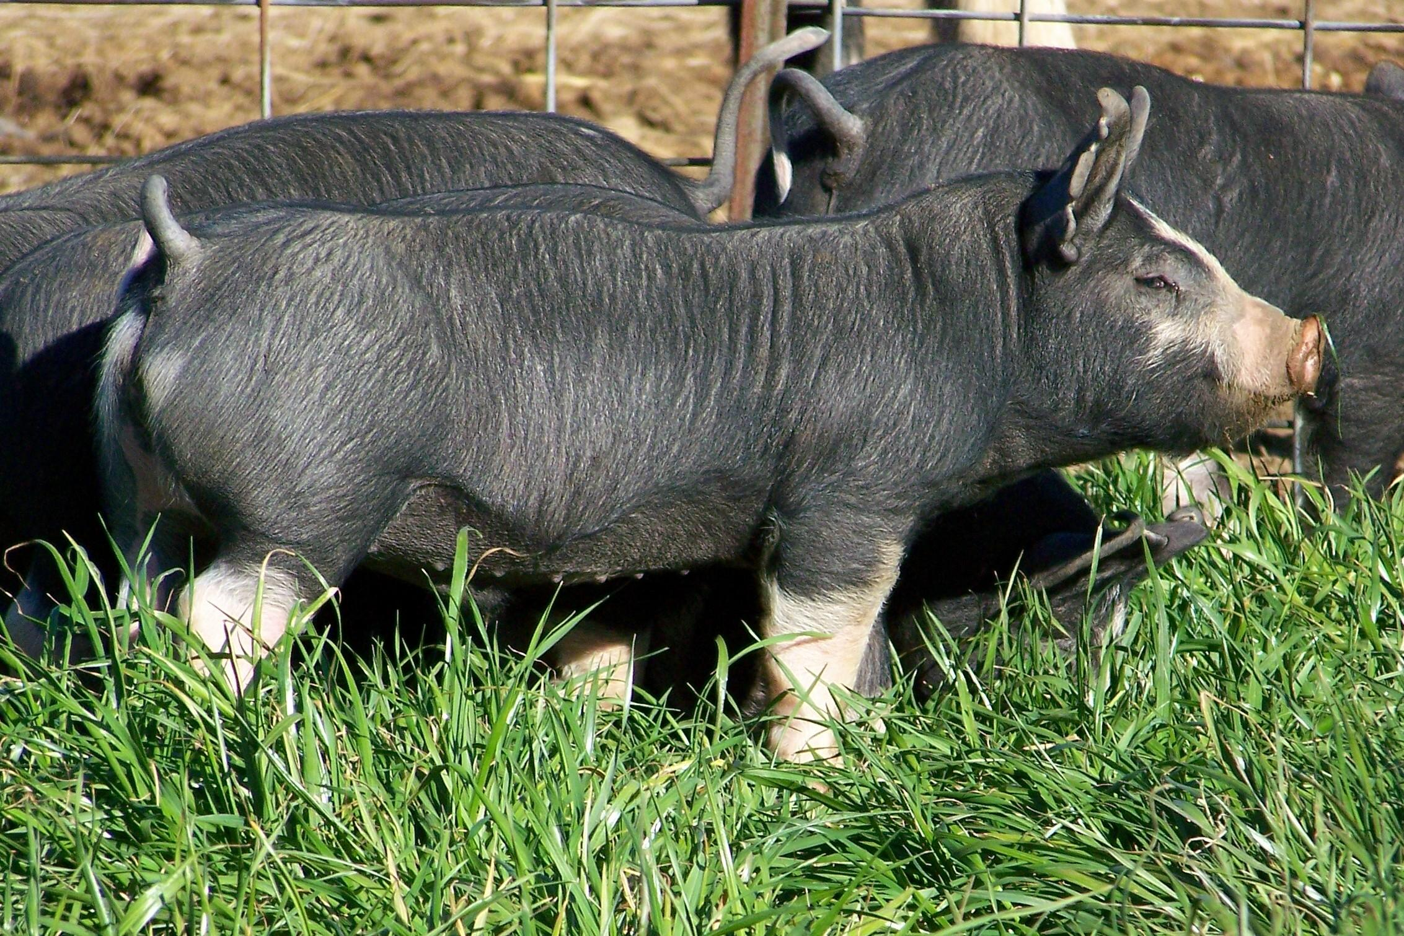
Berkshire

Slide 16
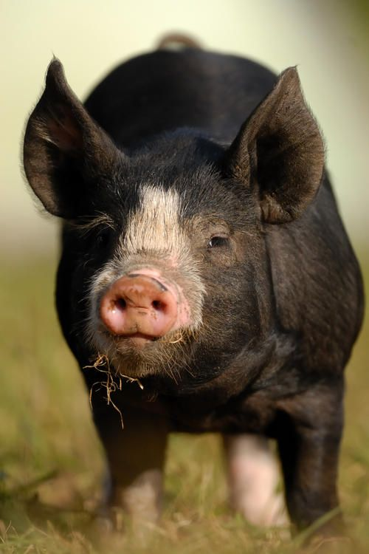
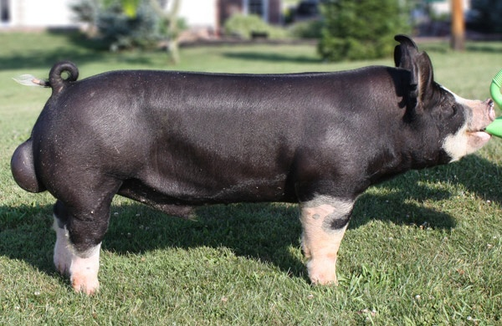
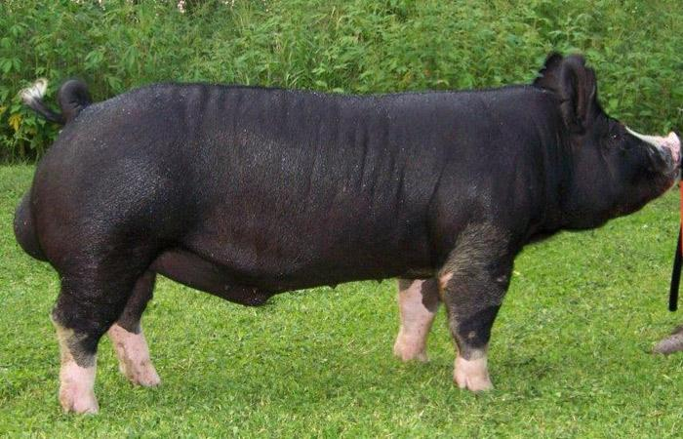
Berkshire (England)
Medium sized breed
Black color with white snout, boots, and tail
Erect ears with a short face

Slide 17
Duroc

Slide 18
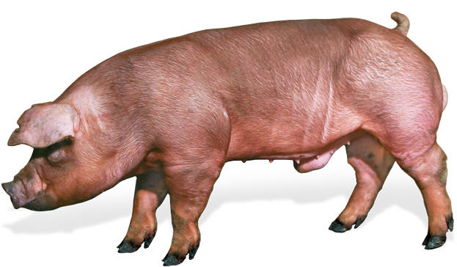
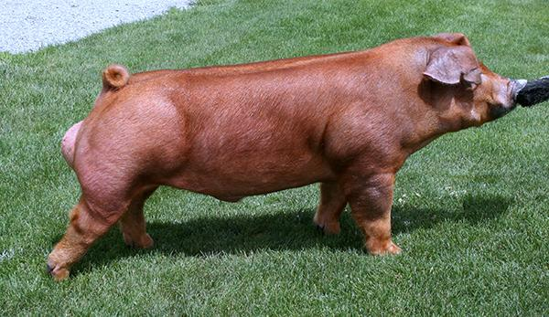
Duroc (USA)
Large breed
Reddish brown skin and hair
Droopy ears
Excellent growth rate and feed efficiency

Slide 19
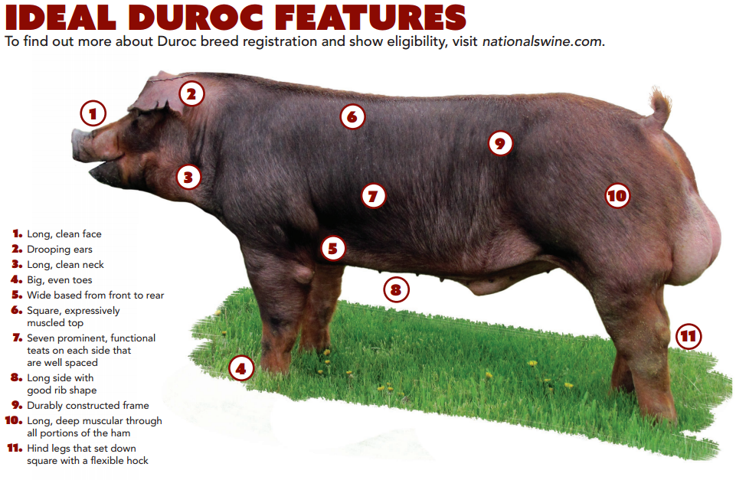

Slide 20
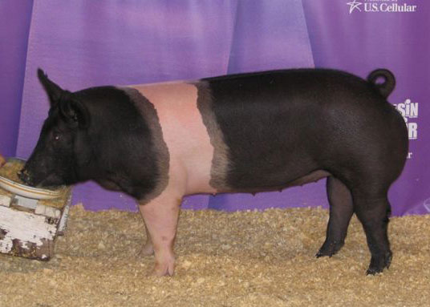
Hampshire

Slide 21
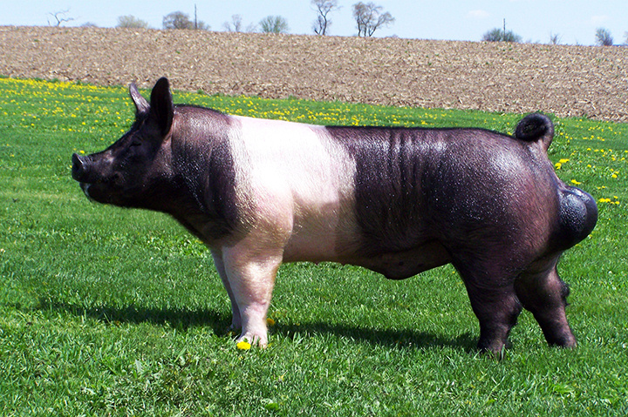
Hampshire (USA)
Large breed
Black with a white belt encompassing their front legs
Erect ears

Slide 22
