Slide 2
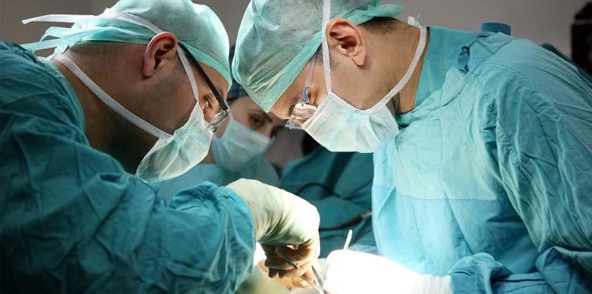
Surgical Instruments:
The following instruments are used during surgery
Many of these look very similar and may be hard to distinguish between!
We will break these tools down into smaller sub-groups:
Forceps: used to pinch or tweeze tissue
Scissors: used to cut tissue
Scalpel/Needle: used to cut or pierce tissue
Surgical miscellaneous

Slide 3
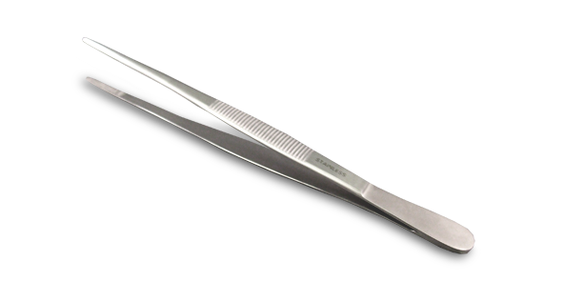
Forceps
Used to grasp and hold objects
You should be able to identify the following forceps:
Alligator
Allis tissue
Babcock tissue
Crile
Kelly
Halstead mosquito hemostatic
Brown-Adson thumb
Rat-tooth thumb

Slide 4
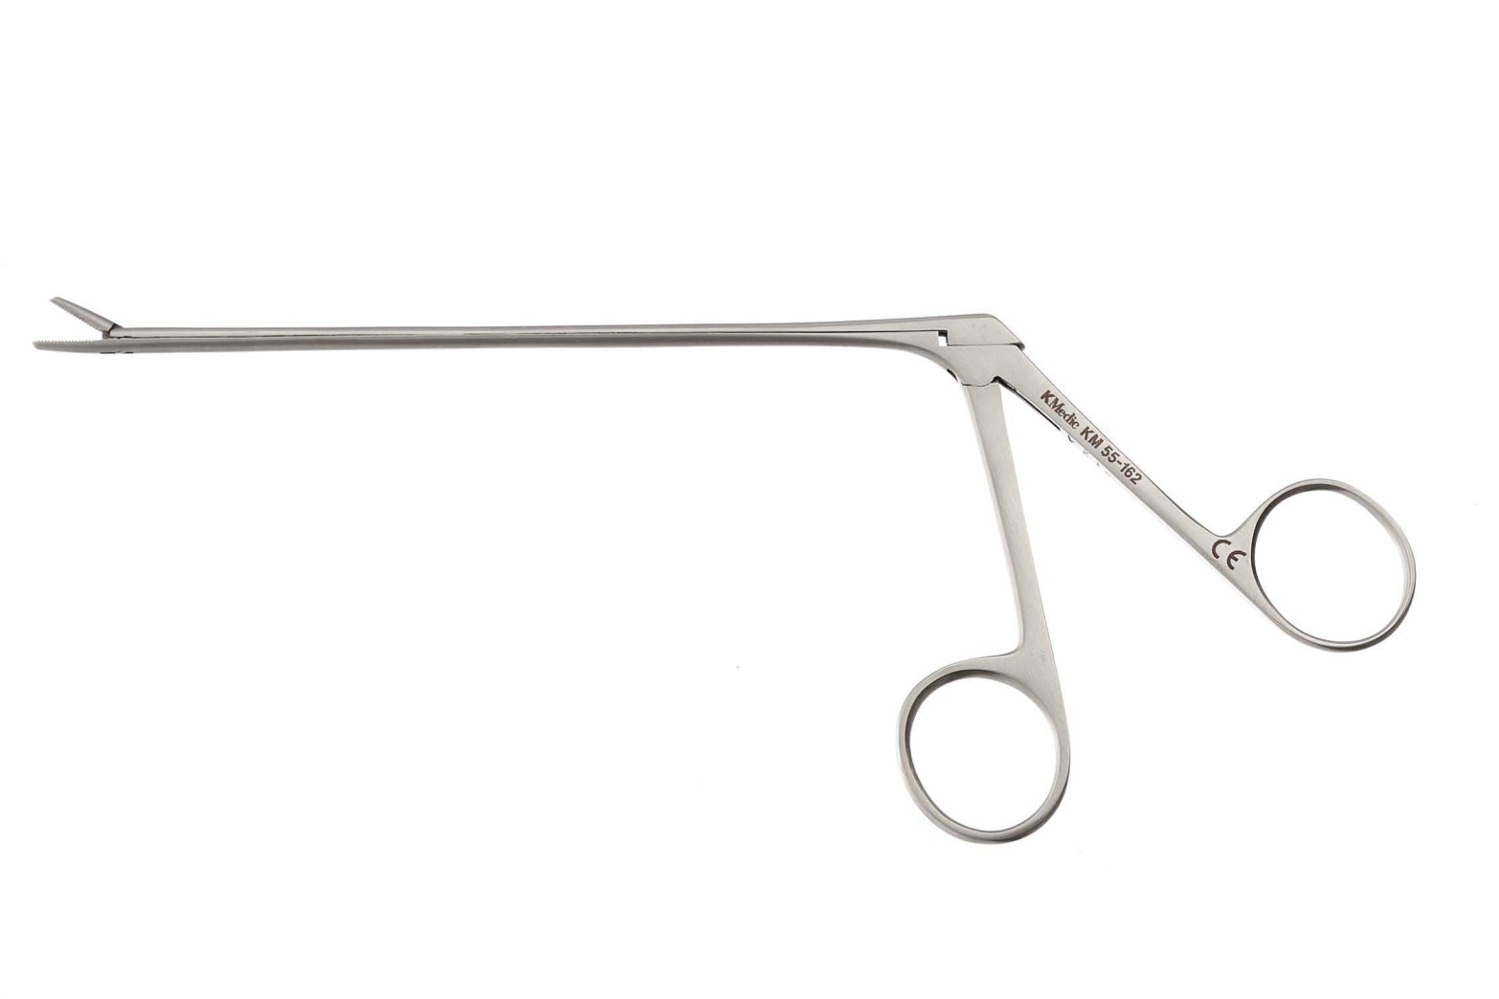
Alligator
Used during surgery to remove foreign bodies
There is a right angle and the top blade is the only part that actually moves

Slide 5
Allis tissue
Used during surgery to grasp organs and slippery/dense tissue
Less delicate than Babcock forceps due to the sharp teeth present at the tip of the blade

Slide 6
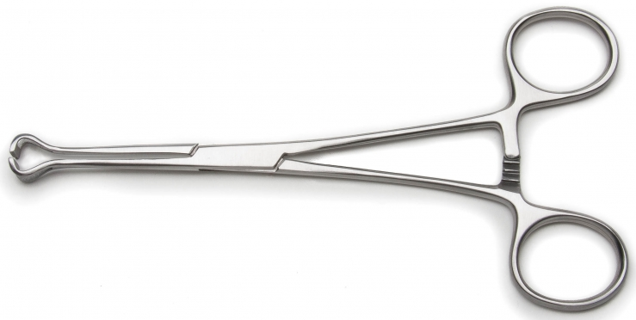
Babcock tissue
Used during surgery to hold delicate tissue
Similar to Allis Tissue forceps but the tips are smooth

Slide 7
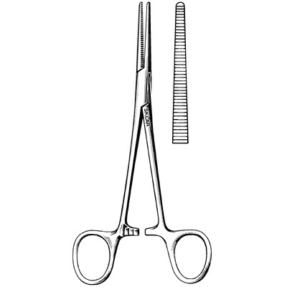
Crile
Used to occlude bleeding before ligation (stops bleeding before closing off a blood vessel)
Serrations run the full length of the jaws, can be curved or straight

Slide 8
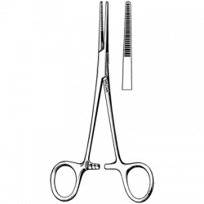
Kelly
Used to occlude bleeding before ligation (stops bleeding before closing off a blood vessel)
VERY similar to Crile forceps, but serrations only run about halfway up the distal length of the jaw, can be curved or straight

Slide 9
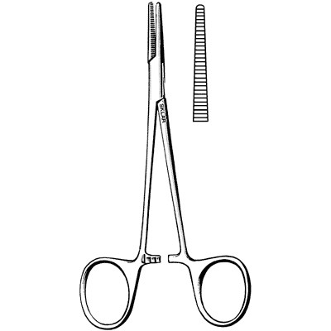
Halstead mosquito hemostatic
Used to occlude bleeding before ligation (stops bleeding before closing off a blood vessel)
SMALLER than the Crile or Kelly, serrations run the full length of the jaws, can be curved or straight

Slide 10
Brown-Adson thumb
Used during surgery to grasp and hold tissue, muscle, or skin
Fine serrations are present, there are no teeth at the tip

Slide 11
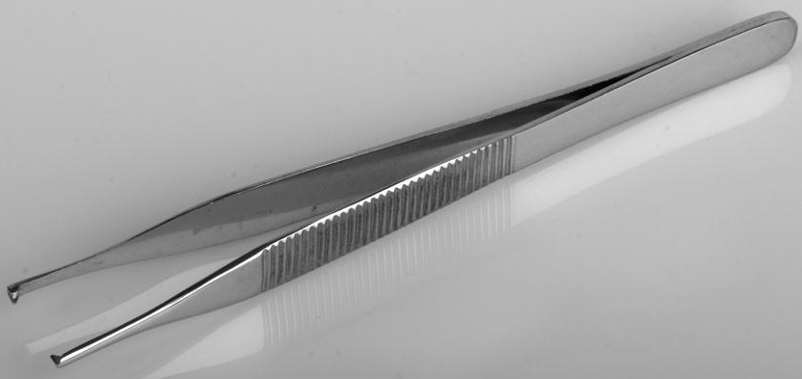
Rat-tooth thumb
Used during surgery to grasp and hold tissue, muscle, or skin
Difference between Brown-Adison and rat tooth is the rat tooth has teeth at the tip of the instrument

Slide 12
Scissors
Surgical instruments used for cutting material and tissue
You should be able to identify the following scissors:
Suture wire cutting
Bandage
Littauer suture removal
Mayo dissecting
Metzenbaum dissecting

Slide 13
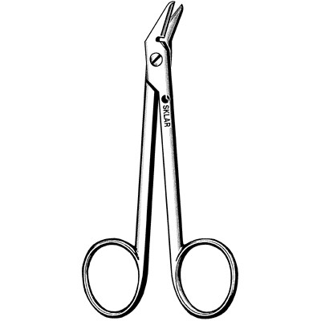
Suture wire cutting
Used to cut wire sutures
The blades are serrated, can be curved or straight

Slide 14
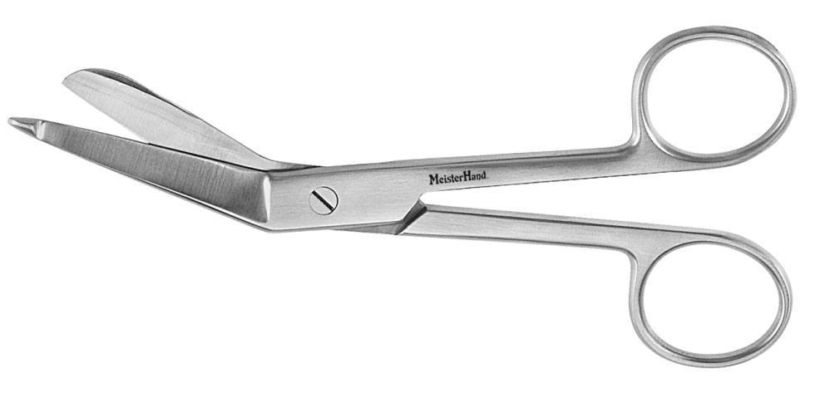
Bandage
Used to remove bandages
There are many types of bandage scissors, but they will all have a longer bottom blade that has a blunt tip (helps to prevent cutting skin)

Slide 15
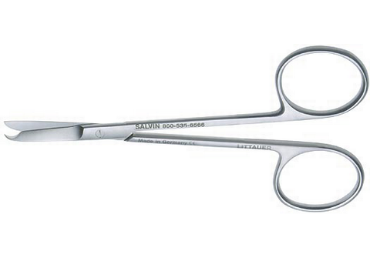
Littauer suture removal
Used to cut all kinds of sutures (but wire)
Has a hook-shaped bottom blade
Can be curved or straight

Slide 16
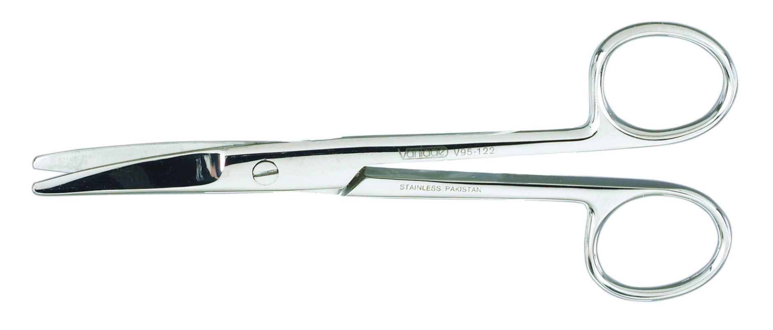
Mayo dissecting
Used during surgery to cut body tissues and sutures
Have blunt ends with a shorter and broader shanks than Metzenbaum, can be curved or straight

Slide 17
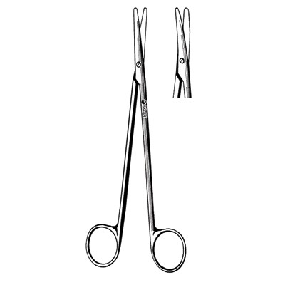
Metzenbaum dissecting
Used during surgery to cut delicate tissue
Longer and more narrow shanks than Mayo scissors
Can have curved or straight blades

Slide 18
Scalpel/Needle Instruments
You will need to identify the following scalpel/needle instruments:
Scalpel blade
Scalpel handle
Suture needle
Cutting
Taper
Needle holder
Mayo-Hegar
Olsen-Hegar
The needle holders are used during suturing of the patient, a ratchet is present near the finger rings, meaning that they lock in place when closed (this is to prevent the needle from slipping!)

Slide 19
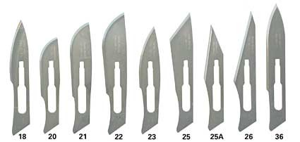
Scalpel blade
Used in surgery to cut through different tissues
An extremely sharp blade that attaches to a scalpel handle

Slide 20
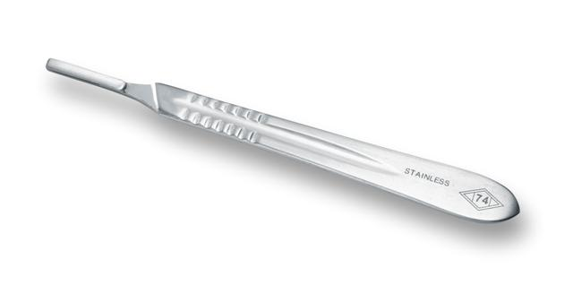
Scalpel handle
Used during surgery to hold the scalpel blade, making it easier for the veterinarian to manipulate the blade

Slide 21
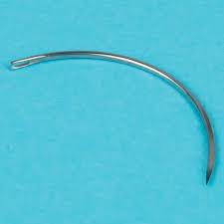
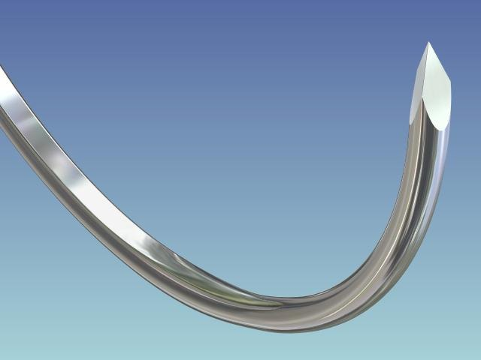
Suture needle - cutting
Often used during surgery to close skin and subcutaneous tissue
Needle point is triangular with a cutting edge

Slide 22
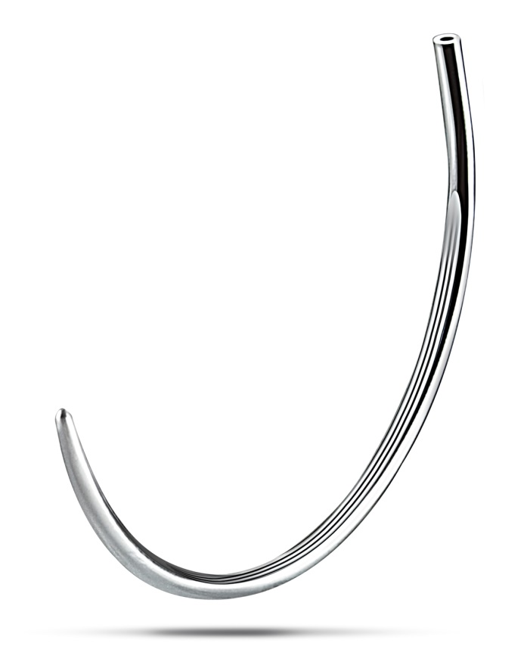
Suture needle - taper
Often used in surgery to close soft tissue (ex. fascia, gastrointestinal tissue, vascular tissue)
No cutting edge on the tip

Slide 23
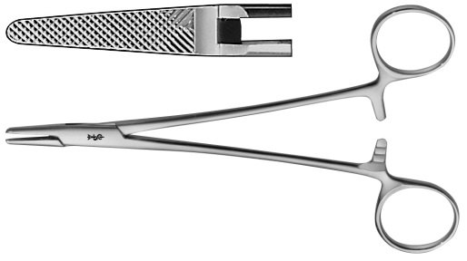
Needle holder (Mayo-Hegar)
Used in surgery to hold the needle while suturing tissue
No cutting blades

Slide 24
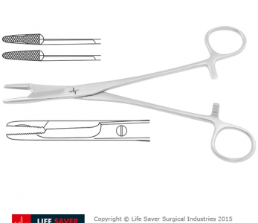
Needle holder (Olsen-Hegar)
Used in surgery to hold the needle while suturing tissue and to cut suture material
Similar to Mayo-Hegar but also has cutting blades on the proximal end of the blade

Slide 25
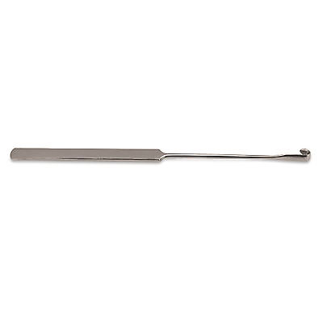
Surgical Miscellaneous
You will need to identify the following:
Blackhaus towel clamps
Snook ovariohysterectomy hook
Staple remover
Anesthetic machines
Endotracheal tubes
Surgical drapes

Slide 26
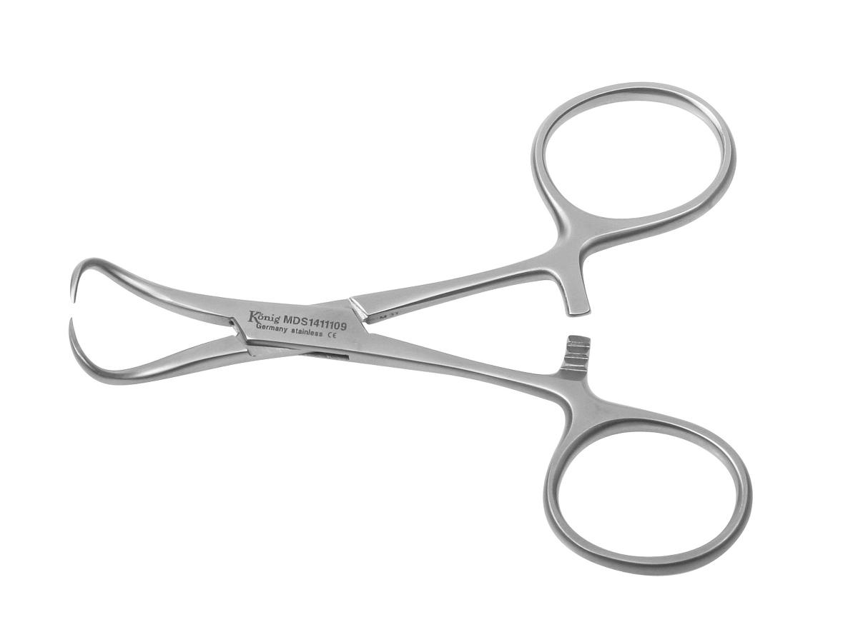
Blackhaus towel clamps
This instrument is used to secure drapes and towels during surgery
Also has a ratchet, like needle holders

Slide 27
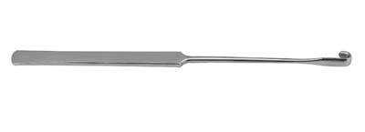
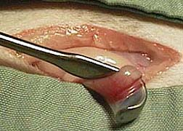
Snook ovariohysterectomy hook
AKA “Snook hook”
Used during a cat or dog spay (aka ovariohysterectomy) to locate and exteriorize the horn of the uterus

Slide 28
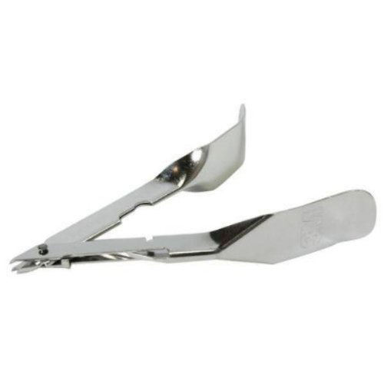
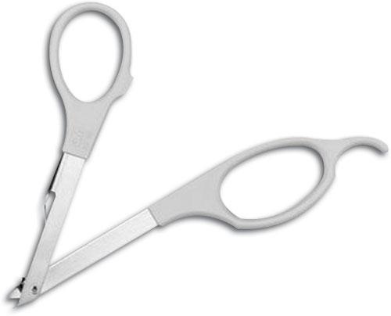
Staple remover
Used to remove staples after surgery or another veterinary procedure

Slide 29
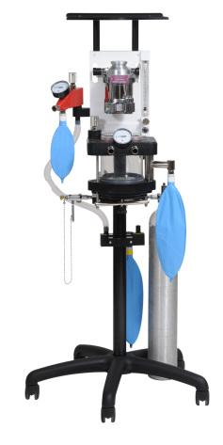
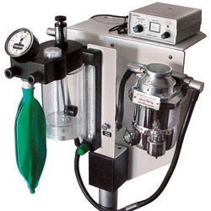
Anesthetic Machines
This machine is used to help administer anesthesia to patients

Slide 30
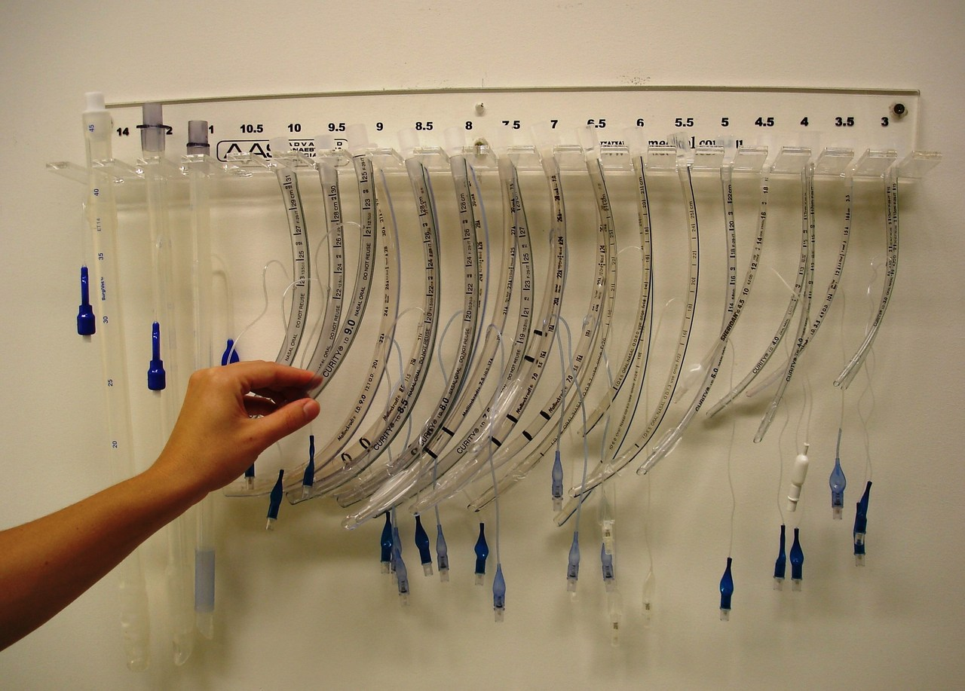
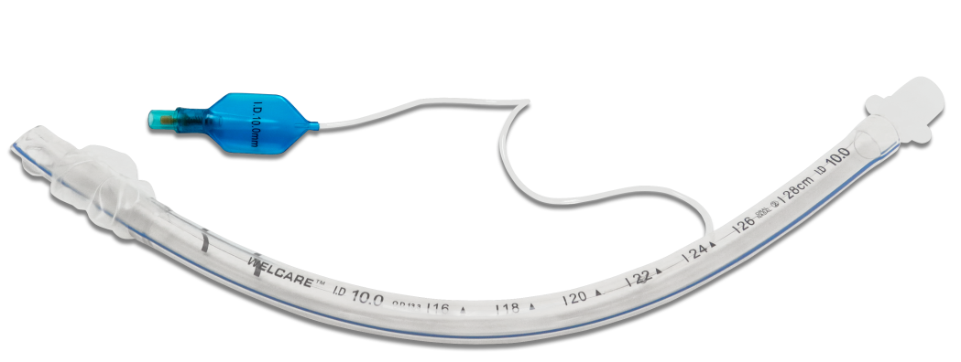
Endotracheal tubes
Used during surgery or any other procedure where the patient is given general anesthetic
Inserted into the trachea of the patient (large or small animal)

Slide 31
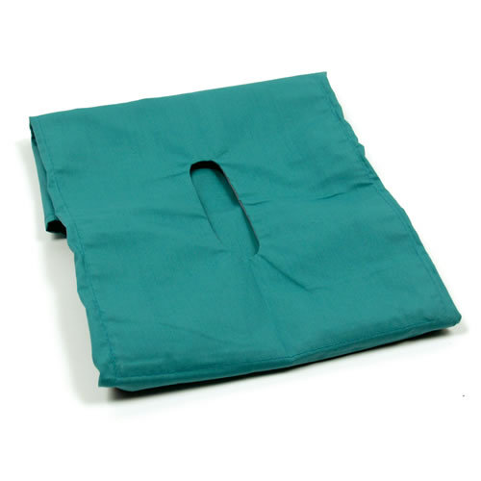
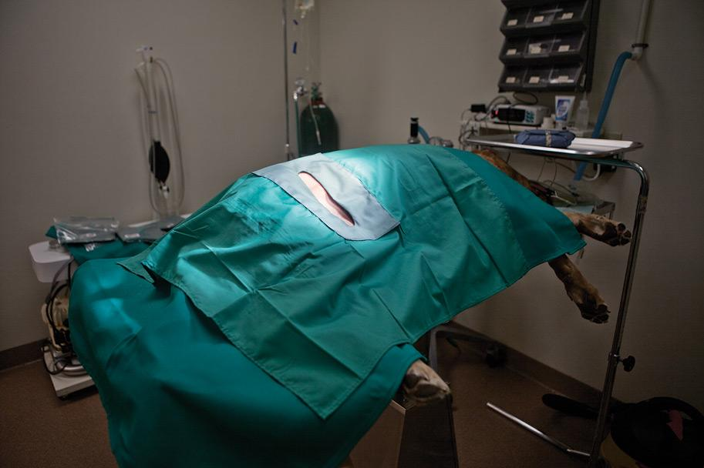
Surgical drapes
Used during surgery to prevent contamination of the surgical area

Slide 32
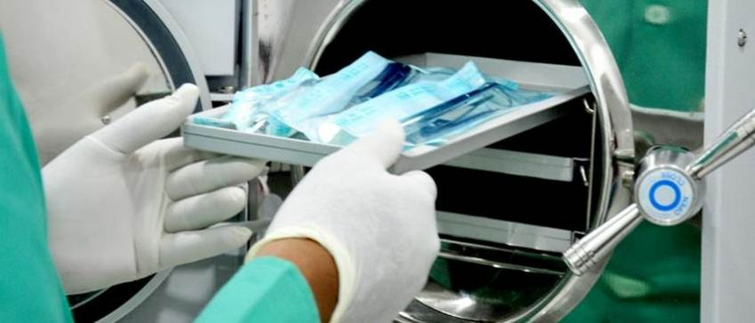
Sterilization Instruments
The following machines and tools are used to sterilize veterinary instruments for surgery and other procedures
You will need to identify the following tools:
Autoclave
Autoclave tape indicator
Chemical indicator strips
Cold sterile tray

Slide 33
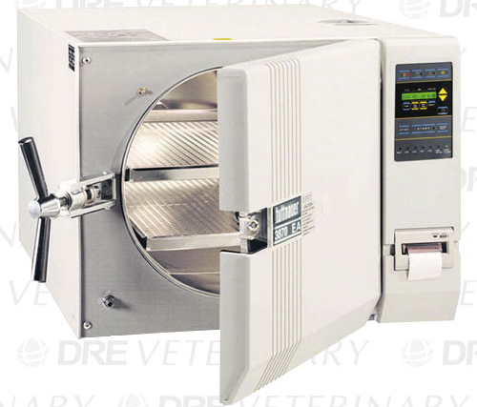
Autoclave
This machine is used to sterilize veterinary instruments for surgery and other procedures
It used high heat and pressure to sterilize

Slide 34
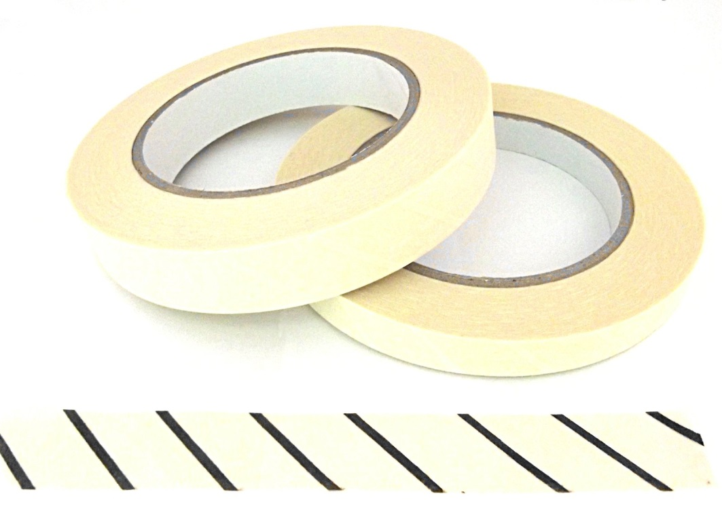
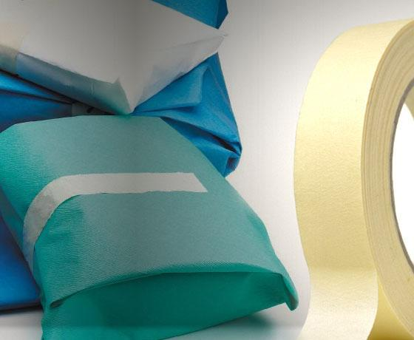
Autoclave tape indicator
This tape is put on surgery packs before being autoclaved
If the autoclave works properly, then stripes on the tape turn black (or another color), indicating that the contents of the pack have been properly sterilized

Slide 35
Chemical indicator strips
Another way to identify sterilization in surgical packs
Strip changes color after sterilization

Slide 36
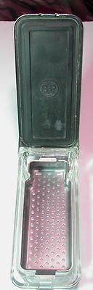
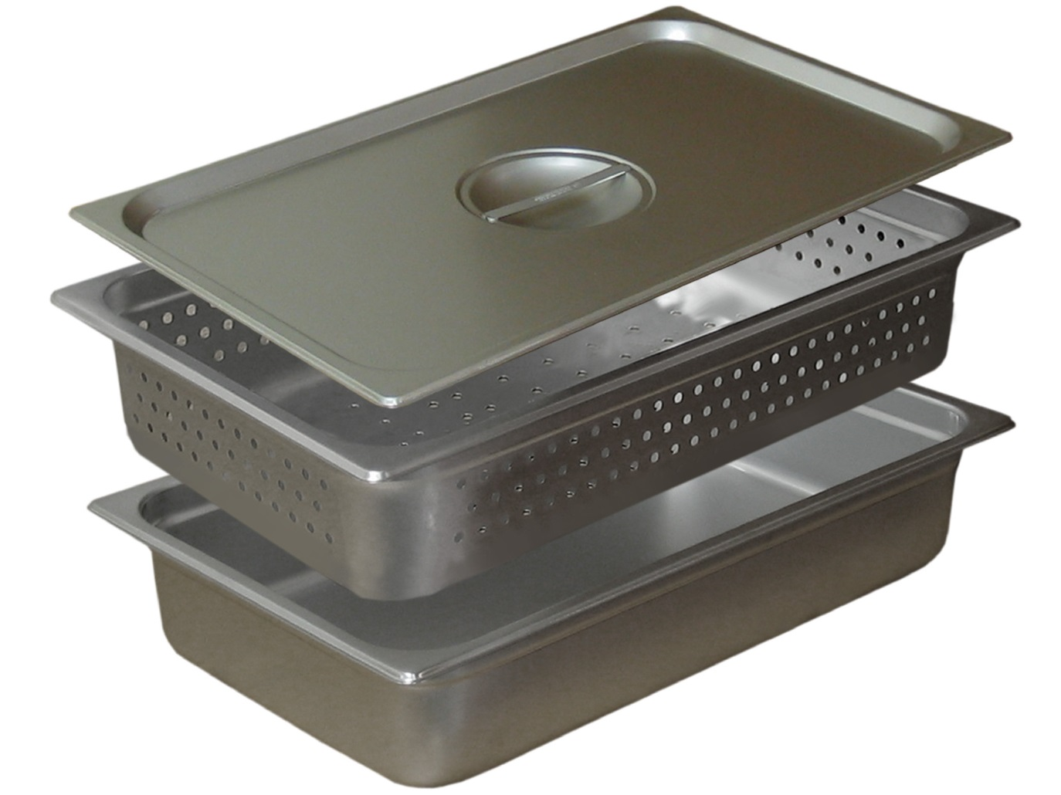
Cold sterile tray
Another way to sterilize instruments
No heat is applied, instead chemicals are used

Slide 37
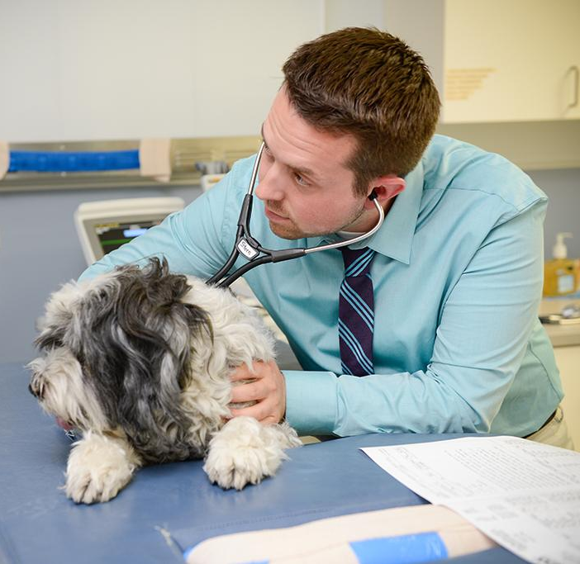
Examination/Diagnostic Tools
These tools are used in the examination or diagnostic process at the veterinary clinic
You will need to identify the following tools:
Centrifuge
Endoscope
Laparoscope
Laryngoscope
Ophthalmoscope
Otoscope
Stethoscope
Tonometer

Slide 38
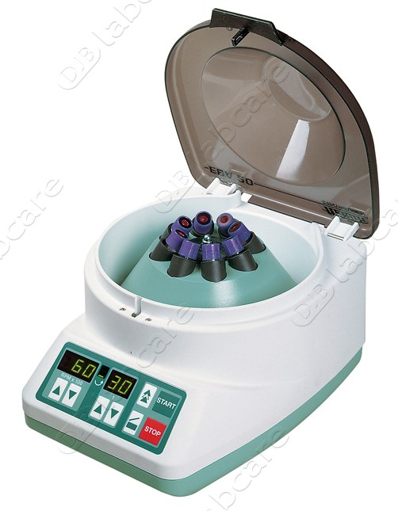
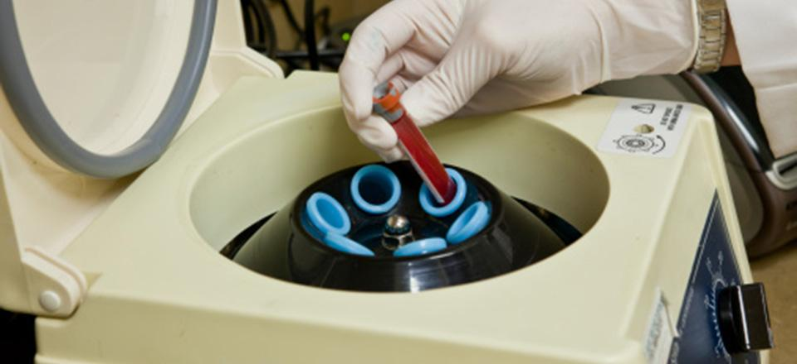
Centrifuge
A machine that uses centrifugal forces to “spin down” body fluids
Often used on blood and urine
This machine spins very fast, so special care must be taken to ensure that it is balanced before running the machine!

Slide 39
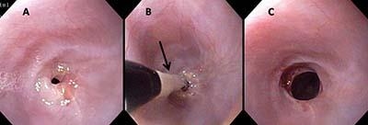
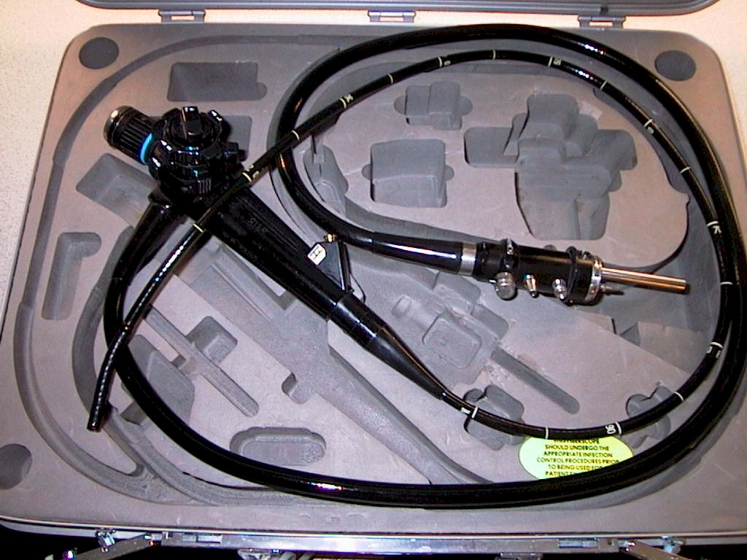
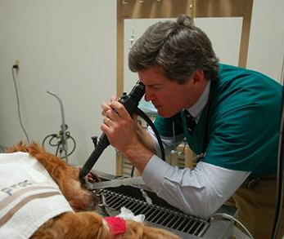
Endoscope
This instrument is used to give veterinarians a view of the patients internal parts
A camera is attached to the front of the endoscope, which allows the veterinarian to see

Slide 40
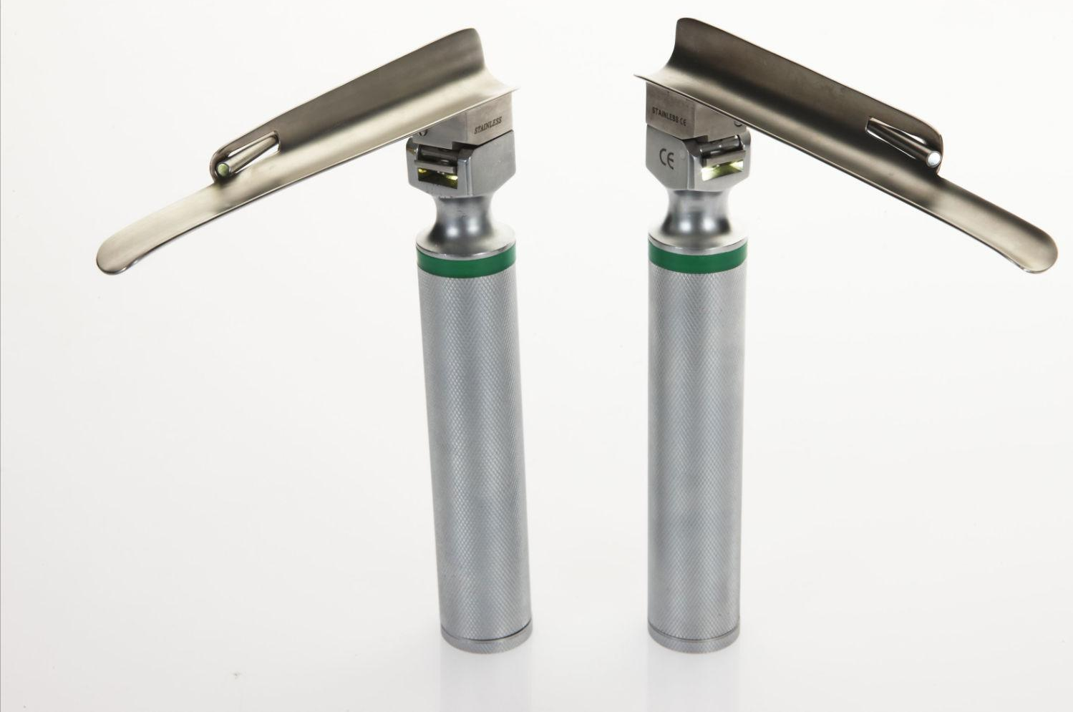
Laryngoscopes
Used to view the vocal cords
Often used to facilitate intubation

Slide 41
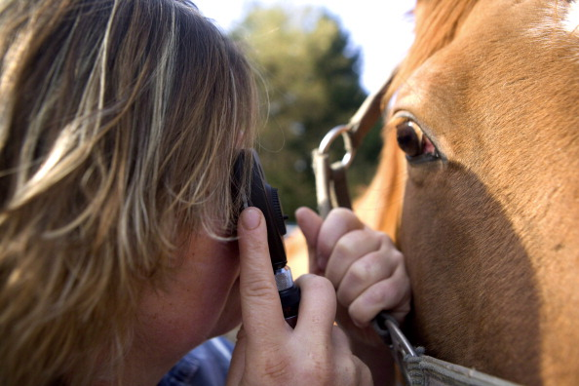
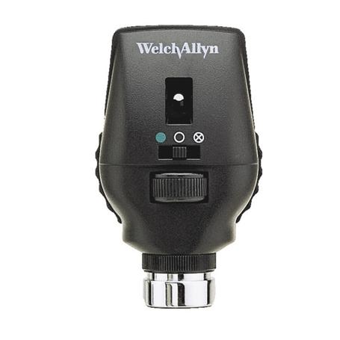
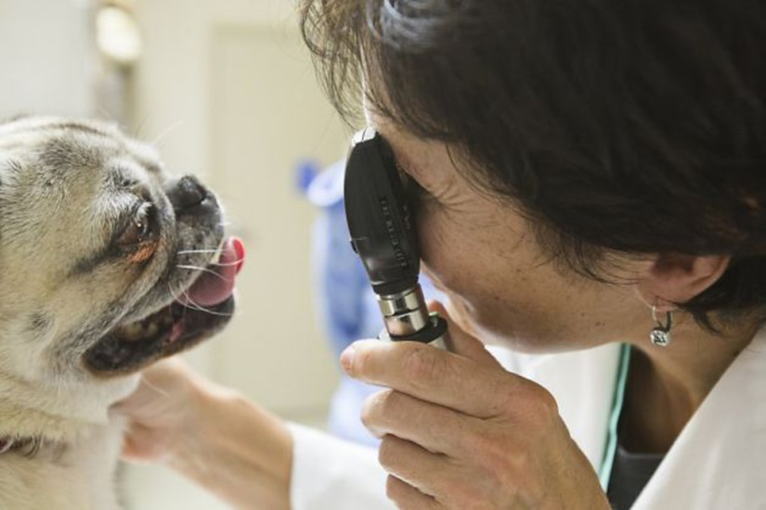
Ophthalmoscope
Used to view and examine the patients eyes

Slide 42
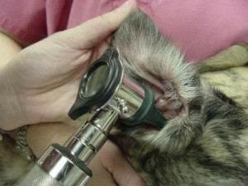
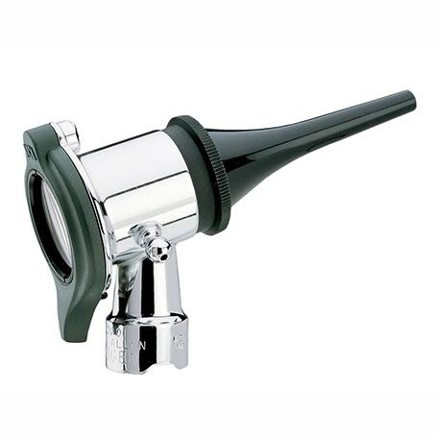
Otoscope
Used to view and examine the patients ears

Slide 43
Stethoscope
Used to monitor and listen to heart beats, breath sounds, gastric sounds, etc.

Slide 44
Tonometer
Used to test the pressure inside of the patients eyes

Slide 45
IV Instruments
These instruments are used to collect blood samples or to administer medicine intravenously
You will need to identify the following tools:
Catheters
Butterfly
IV
IV administration set

Slide 46
Catheter - butterfly
Used to draw blood from patients

Slide 47
Catheter - IV
Used to draw blood from patients

Slide 48
IV administration set
Used along with an IV catheter to administer fluids or other medication to the patient

Slide 49
Dental Instruments
These tools are used on dental examinations or procedures for various species
You will need to identify the following tools:
Balling gun
Dental floats
Dental scaler
Drench gun (small ruminant)
Pig tooth nippers
Oral speculums
Large animal
Small animal

Slide 50
Balling gun
This device is used to administer capsules and boluses to livestock animals (mainly cattle)

Slide 51
Dental floats
This device is used on horses to float (or rasp down) points on their teeth

Slide 52
Horse floatation video

Slide 53
Dental scaler
This instrument is used on small animals to remove plaque from their teeth

Slide 54
Drench gun (small ruminant)
This device is used to administer oral medicine to small ruminant animals (goats and sheep)

Slide 55
Pig tooth nippers
Used on baby pigs to remove their needle teeth
HINT: look a lot like pliers

Slide 56
Oral speculum – large animal
Used to open the mouth of large animals
Often used during horse dental floatation
HINT: used in the horse floatation video!

Slide 57
Oral speculum – small animal
Used in small animal species to open the mouth
Often used during dental procedures

Slide 58
Bandaging Tools
These tools are used to help bandage:
Elastikon
Roll gauze
Vet wrap

Slide 59
Elastikon
Used in bandaging to provide elasticity in pressure dressings
Has an adhesive side

Slide 60
Roll gauze
Used in bandaging for moderate compression
There is not adhesive size, but provides absorbency and breathability

Slide 61
Vet wrap
Used in bandaging, self adherent
Often used to hold gauze in place

Slide 62
Restraint tools:
The following tools are used to restrain various animal species during veterinary procedures
There are the tools that you will need to identify:
Cat bag
Catch pole (dog snare)
Basket muzzle
Nylon muzzle
Chain twitch
Humane twitch
Head gate
Squeeze chute
Hog snare

Slide 63
Cat bag
Device used to help veterinary staff restrain cats
Zippers are present around the limbs and anus to aid in blood draws and other examination procedures

Slide 64
Catch pole (dog snare)
Used to help veterinary staff catch and transport aggressive or infectious dogs

Slide 65
Basket muzzle
Used to restrain aggressive dogs
Protects the staff and animal

Slide 66
Nylon muzzle
Used to restrain aggressive dogs
Protects the staff and animal

Slide 67
Chain twitch
A device used to restrain horses, placed around the top lip, thought to release endorphins and calm the horse
Made of wood and a metal chain loop that is twisted

Slide 68
Humane twitch
A device used to restrain horses, placed around the top lip, thought to release endorphins and calm the horse
Made of a metal clasp that has a rope at the end to maintain pressure

Slide 69
Head gate
Used to restrain cattle for various procedures

Slide 70
Squeeze chute
Machine used to restrain cattle

Slide 71
Hog snare
Used to catch and transport hogs

Slide 72
Reproductive Tract Instruments
The following tools are used to castrate livestock, aid in parturition, or evaluate the reproductive tract
You will need to identify the following tools:
Castration and docking bands (docking is not a reproductive procedure)
Elastrator
Emasculator
Fetal extractor - calf
Obstetrical chain and handle
Vaginal speculum

Slide 73
Bands (castration and docking)
Rubber rings used to castrate and dock livestock animals

Slide 74
Elastrator
Used to castrate and dock livestock animals
A band is placed on the device, which stretches the band and helps place the band around the testes or tail

Slide 75
Emasculators
Used to castrate livestock animals
Crushes and cuts the spermatic cord

Slide 76
Fetal extractor - calf
Used during parturition to facilitate extraction of the calf

Slide 77
Obstetrical chain and handle
Used during parturition in cattle to help deliver the calf

Slide 78
Vaginal speculum
Used to open and examine the vagina and cervix

Slide 79
Small Animal Specific MISC Instruments
These are miscellaneous instruments used in the veterinary practice that are specific to small animal species
You should be able to identify the following tools:
Elizabethan collar
Fecal loop
Fecalyzers
Feeding tube for small animals
Silver nitrate sticks
Small animal oxygen cage
Tomcat urinary catheter
Tourniquet

Slide 80
Elizabethan collar
Used with small animals to promote healing by preventing licking and biting of sutures or other sensitive areas

Slide 81
Fecal loop
Used to collect feces from dogs and cats

Slide 82
Fecalyzers
Used to identify parasites in small animal feces

Slide 83
Feeding tube for small animals
Used to force feed small animals

Slide 84
Silver nitrate sticks
Used to help chemically cauterize blood vessels

Slide 85
Small animal oxygen cage
Used to help provide a higher percentage oxygen to a patient

Slide 86
Catheter – Tomcat urinary
Used to unblock and/or collect urine from male cats
Passed through the penis into the urinary bladder

Slide 87
Tourniquet
Used to temporarily constrict arterial blood flow of a limb
Often used during blood draws

Slide 88
Large Animal Specific MISC Instruments
These are miscellaneous instruments used in the veterinary practice that are specific to large animal species
You should be able to identify the following tools:
Automatic multi-dose syringe
Dehorner
Barnes
Electric
Ear notcher
Hoof knife
Hoof rasp
Rectal prolapse ring (swine)
Rumen magnet
Tattooing instruments (small and large)
Trocar and cannula

Slide 89
Automatic multi-dose syringe
Often used for administering vaccinations to livestock animals

Slide 90
Dehorner - Barnes
This device is used to dehorn livestock

Slide 91
Dehorner - Electric
This device is used to dehorn livestock

Slide 92
Ear notcher
This device is used on swine to identify different pigs
The litter number and pig number are both identified this way

Slide 93
Hoof knife
Used to trim the hooves of livestock animals

Slide 94
Hoof rasp
Used to trim the hooves of livestock animals (mainly horses)

Slide 95
Rectal prolapse ring - swine
Used to correct and prevent further rectal prolapse in swine

Slide 96
Rumen magnet
Given orally to cattle to prevent hardware disease (aka bovine traumatic reticuloperitonitis)
The magnet settles in the reticulum and attracts any metal that is ingested during grazing
Prevents metal from penetrating or irritating the lining of the reticulum

Slide 97
Tattooing instruments – small and large
Often used in livestock species to help identify different individuals

Slide 98
Trocar and cannula
Used in cattle to reduce bloat
Bloat occurs when there is a blockage in the digestive tract and gas produced during the rumination process is not released from the rumen

Slide 99
Veterinary Practice MISC Tools
These are tools that you will find in the veterinary practice that are not associated with any other category that we have discussed so far
You should be able to identify the following tools:
Ambubag
Gravity feeder/J tube
Radiology personal protective equipment

Slide 100
Ambubag
This is a hand-held device that is used to provide ventilation and oxygen to patients who are not breathing or not breathing adequately

Slide 101
Gravity feeder / J tube
Uses gravity to move food down the feeder and fill the fed tray
Used in many species

Slide 102
Radiology personal protective equipment
Lead items that are worn during radiographs to protect the staff member from radiological exposure

