Slide 2
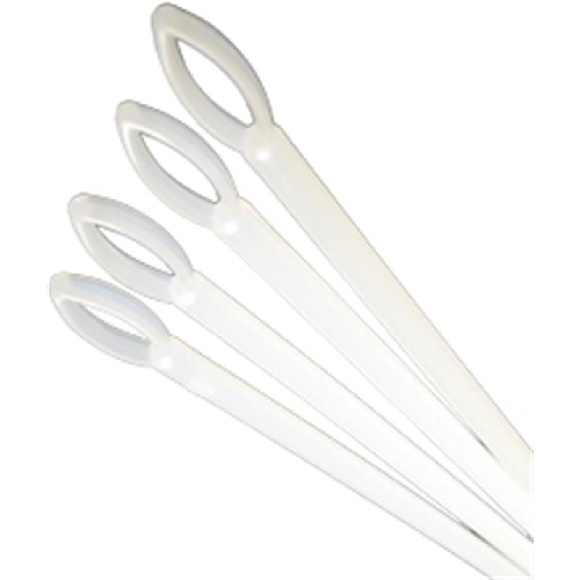

Slide 22
Answer Key
1. Fecal loop
2. Tourniquet
3. IV administration set
4. Mayo Hegar Needle Holder
5. Babcock tissue holder
6. Electric Dehorner
7. Fetal Extractor- Calf
8. Ophthalmoscope
9. Bandaging Material- Elasticon
10. Backhaus towel clamps
11. Obstetrical chain and handle
12. Gravity Feeder/ J tube
13. Small animal feeding tube
14. Elizabethan collar
15. Pig tooth nippers
16. Rumen Magnet
17. Scissors — Littauer suture removal
18. Head gate
19. Crile Forceps
20. Tomcat urinary catheter

