Slide 1
POULTRY
PEER PROGRAM, TEXAS A&M UNIVERSITY

Slide 2
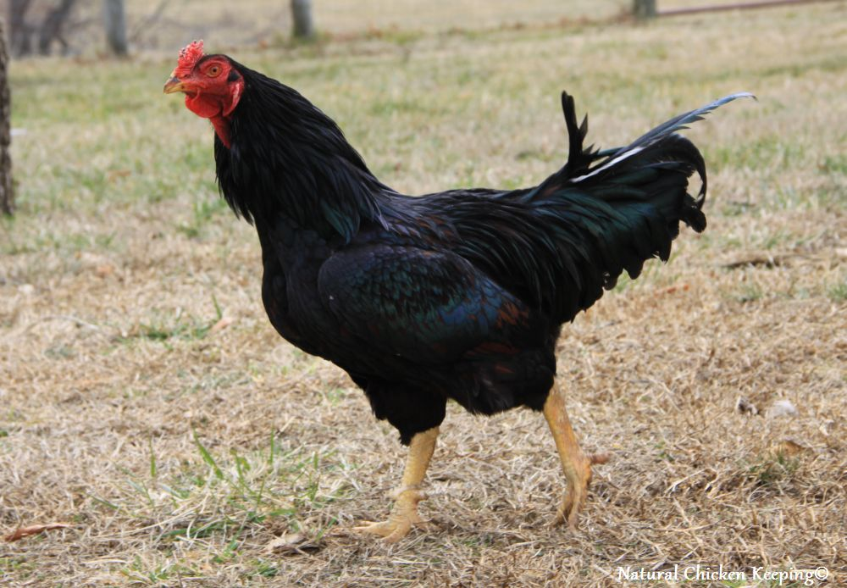
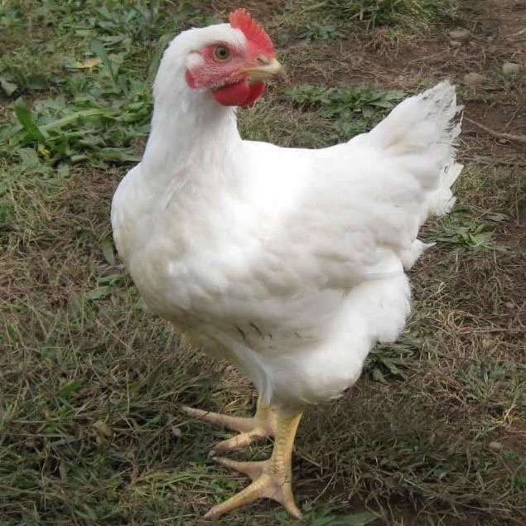
CHICKEN - CORNISH

Slide 3
CHICKEN - CORNISH
First known as the Indian Game chicken, developed in 1820
Very close feathered, with little or no down apparent
Feathers are short and often quite narrow
Wide skulls, medium length necks, thick and short shanks, legs are set wide apart
Bodies when viewed from above are heart shaped

Slide 4
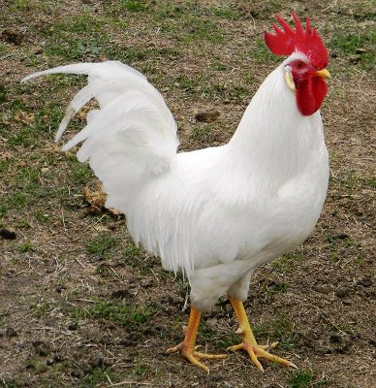
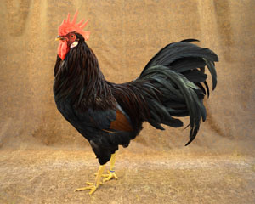
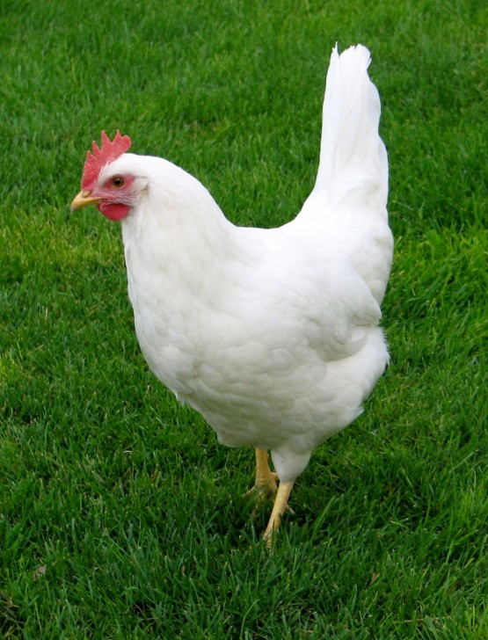
CHICKEN - LEGHORNS

Slide 5
CHICKEN - LEGHORNS
Came from England to U.S. in 1870 (White Leghorns) and 1872 (Brown Leghorns)
Dominate white egg production in America
Males weight ~6lbs, females ~4.5lbs
Once valued for beauty, now more of an industrial bird

Slide 6
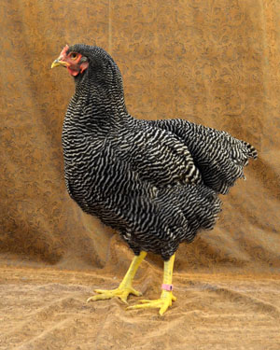
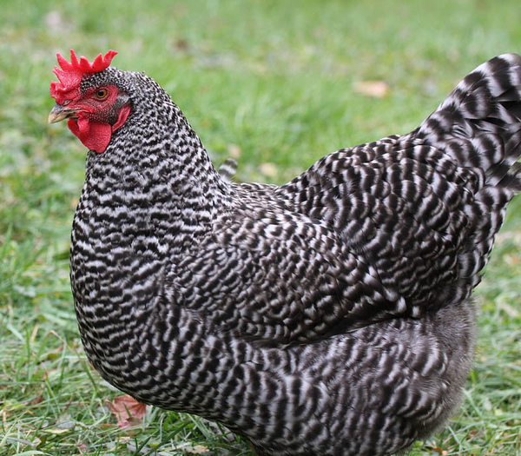
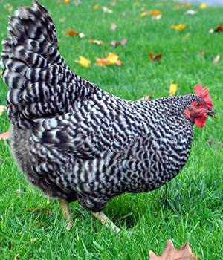
CHICKEN – PLYMOUTH ROCK

Slide 7
CHICKEN – PLYMOUTH ROCK
Developed in the U.S. in the 19th century
Bright red single comb face, wattles, and earlobes
Plumage should have feathers that are crossed by sharply defined, regular, parallel bars of alternate light and dark color
Males are usually lighter in color

Slide 8
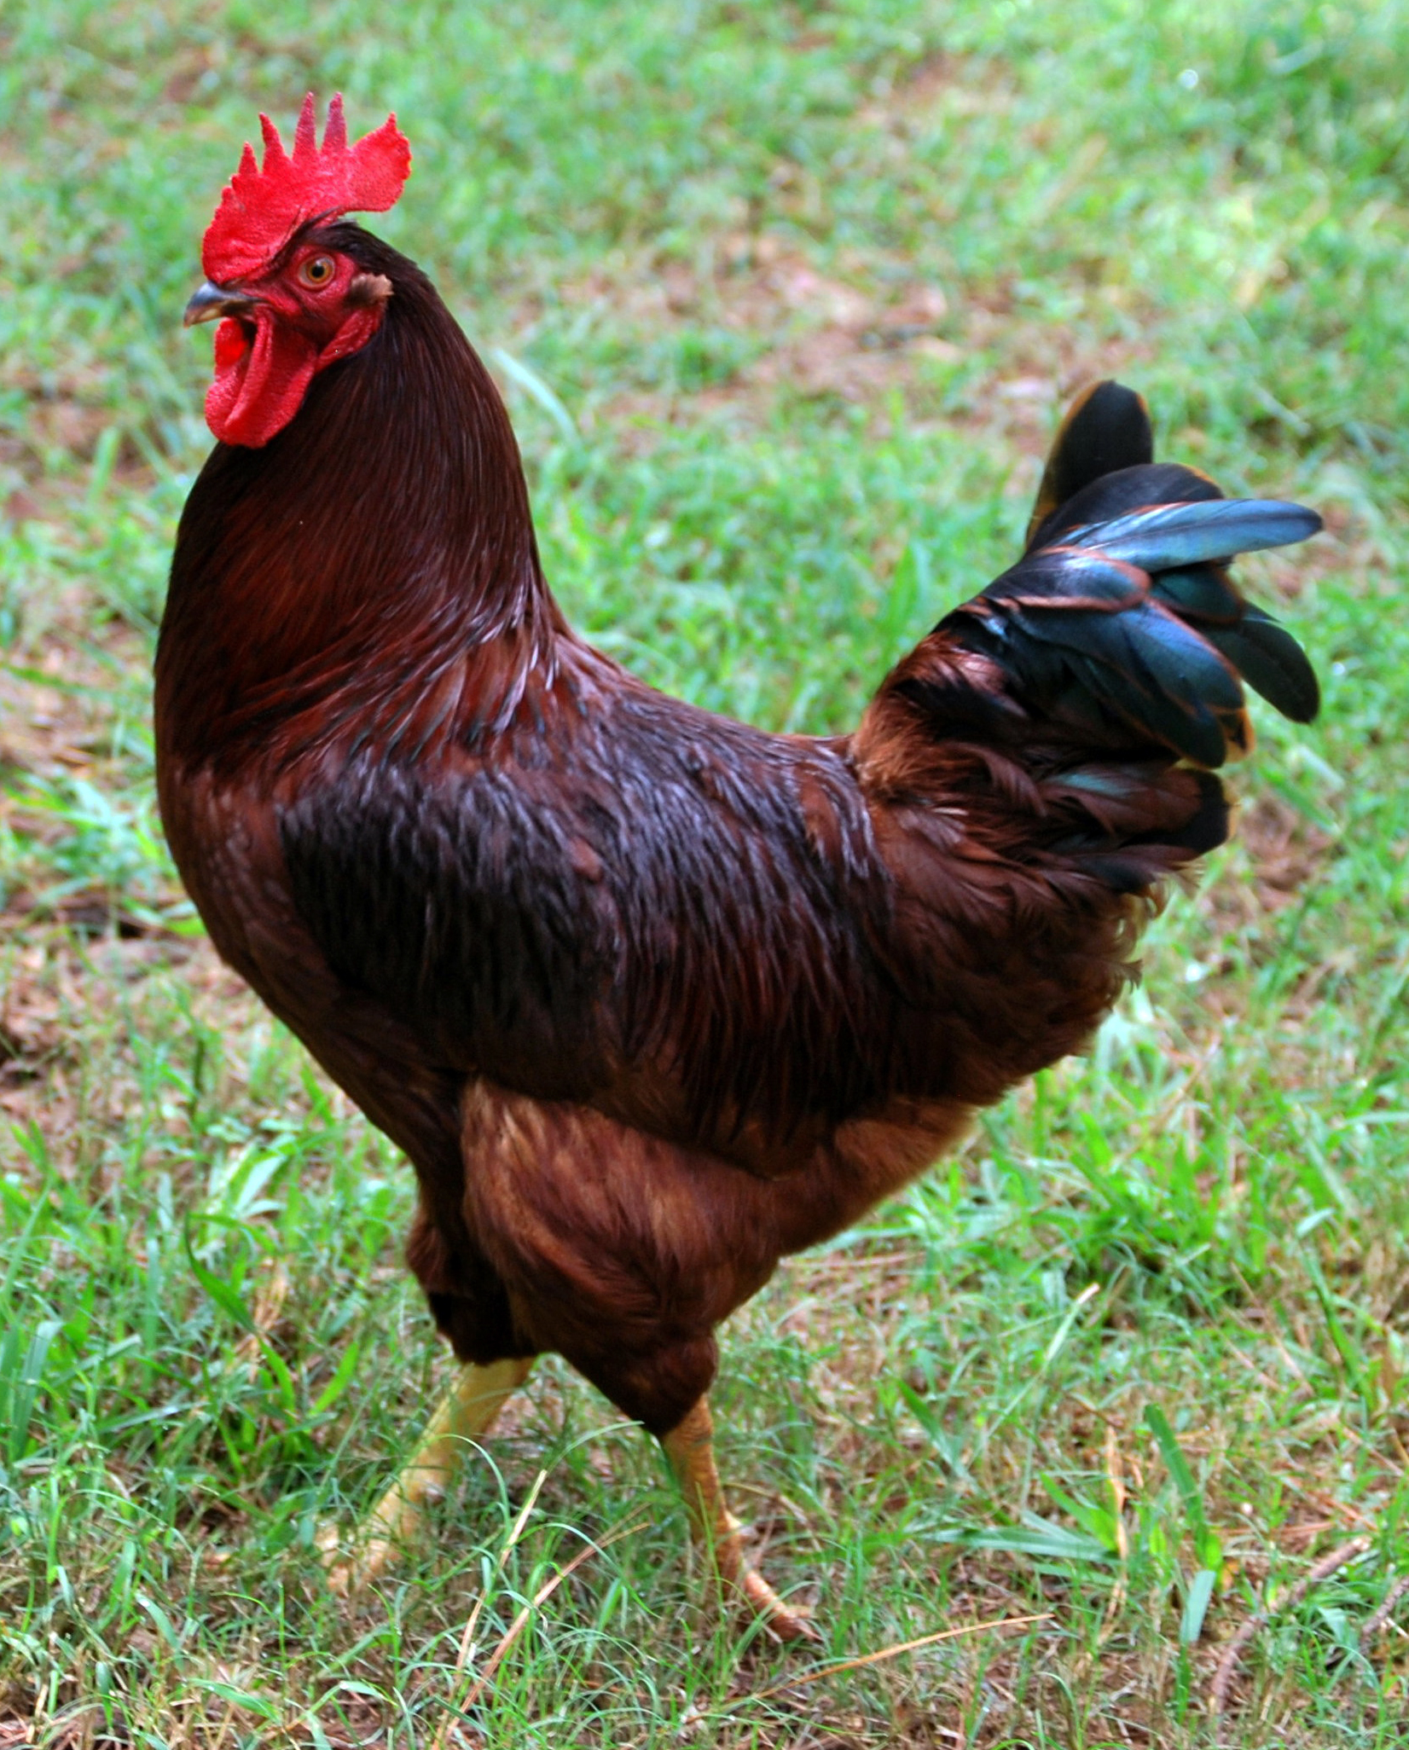
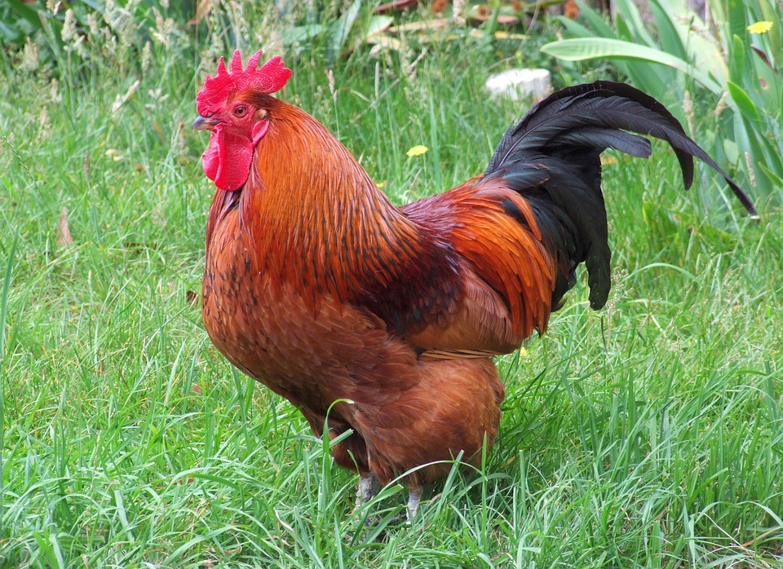
CHICKEN – RHODE ISLAND RED

Slide 9
CHICKEN – RHODE ISLAND RED
America’s best known breed
Originally developed in Massachusetts and Rhode Island in the 1880s
Single-combed
Good layers of brown eggs (200-300/year)
Hens weigh 6lbs, roosters over 8lbs

Slide 10
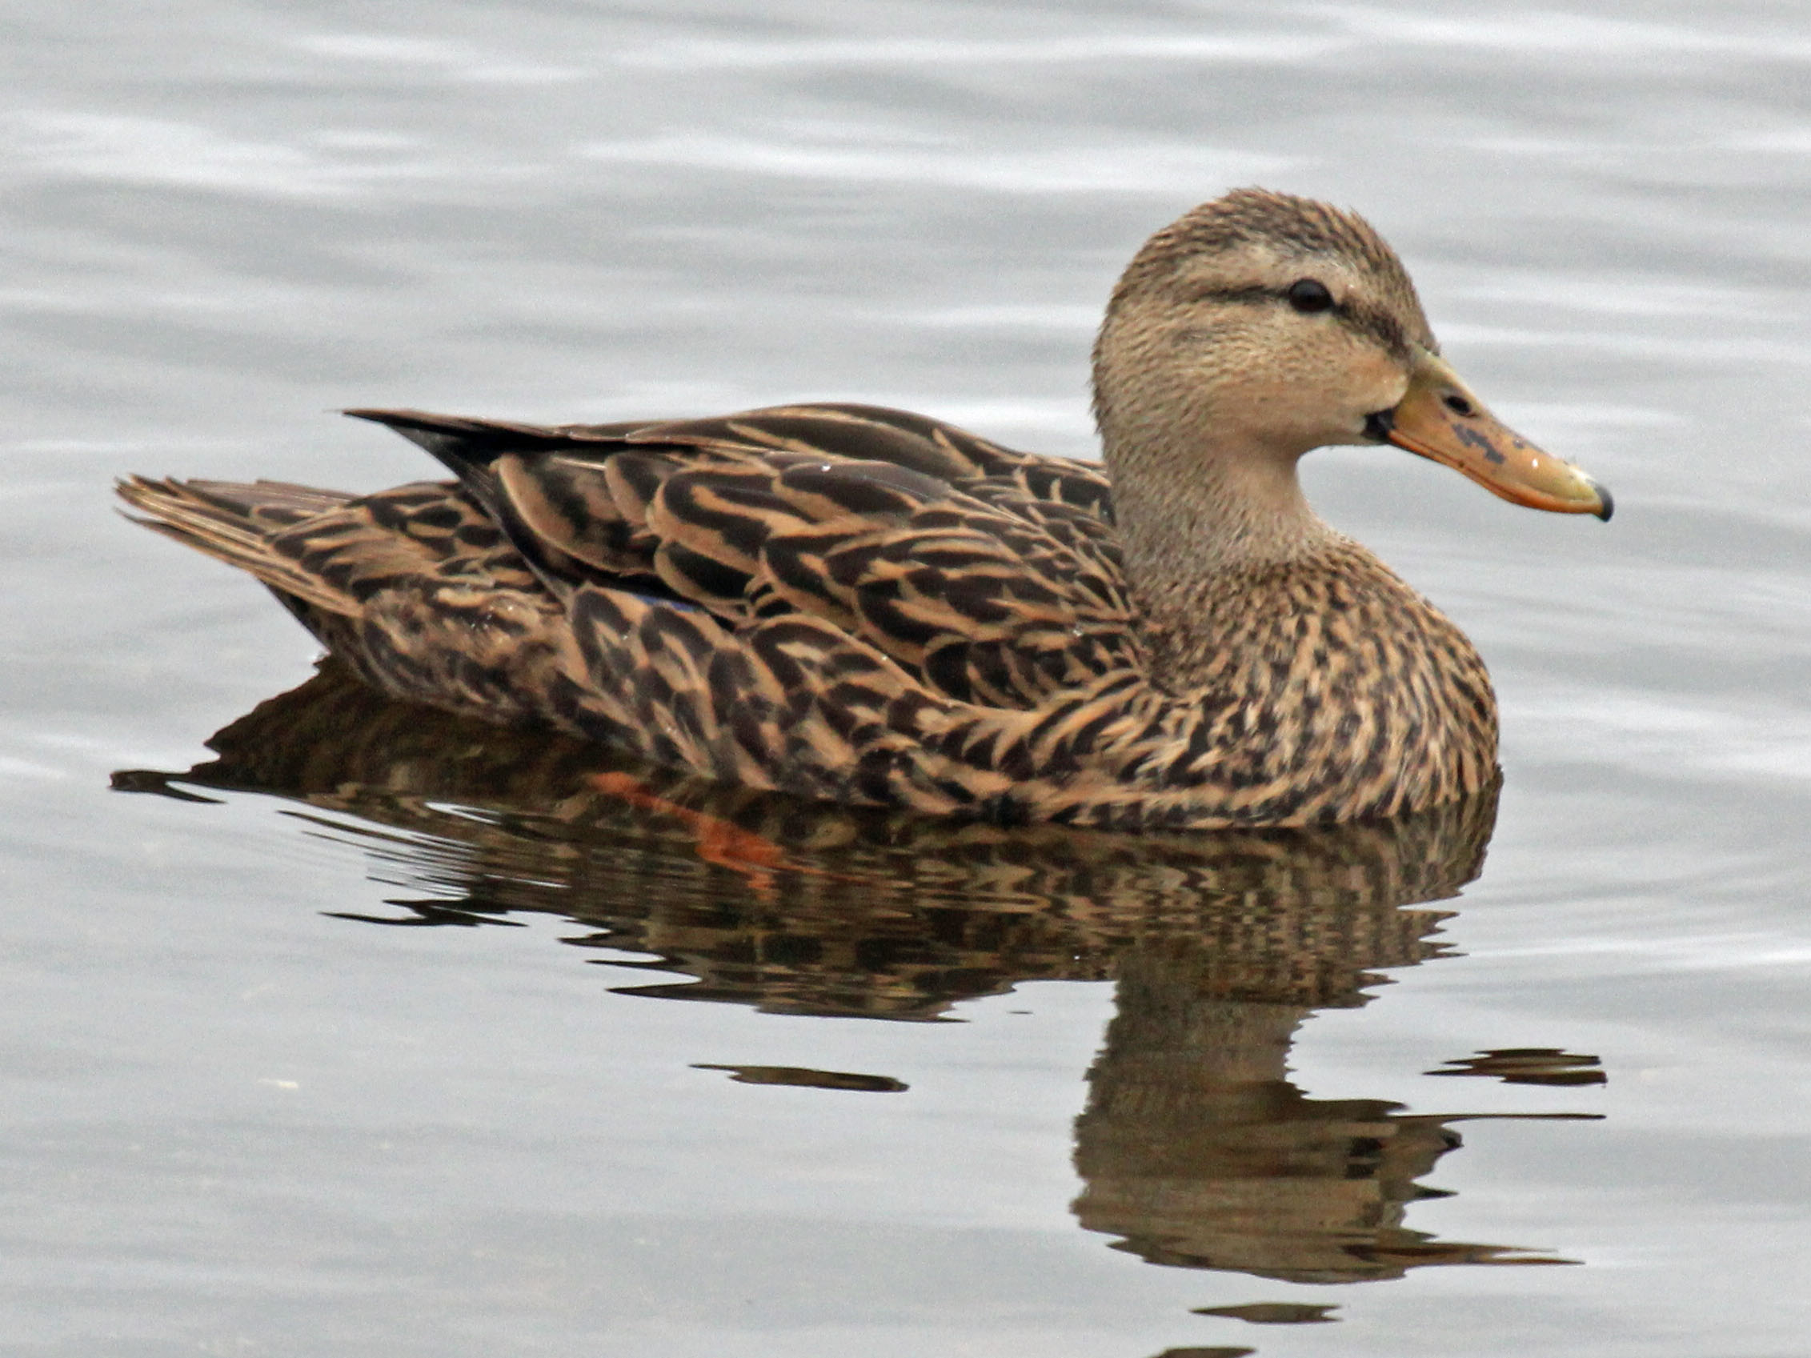
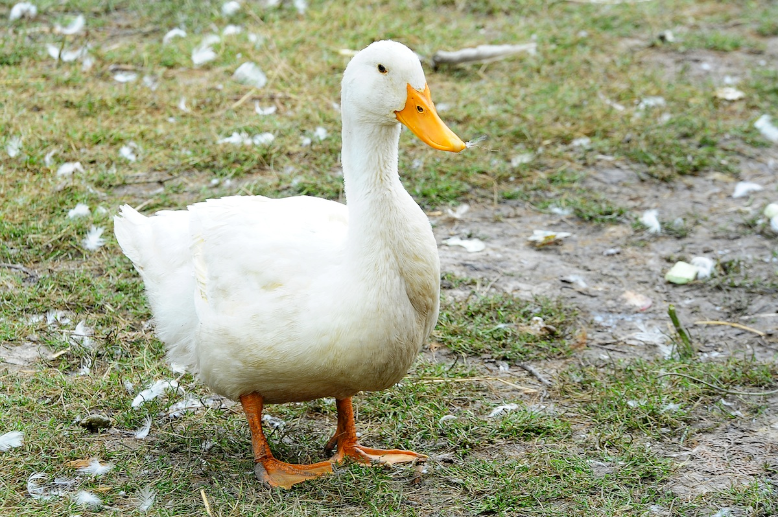
DUCK

Slide 11
DUCK
Around 22 million ducks are raised annually in the U.S.
Raised primarily for meat
Built around the Pekin breed

Slide 12
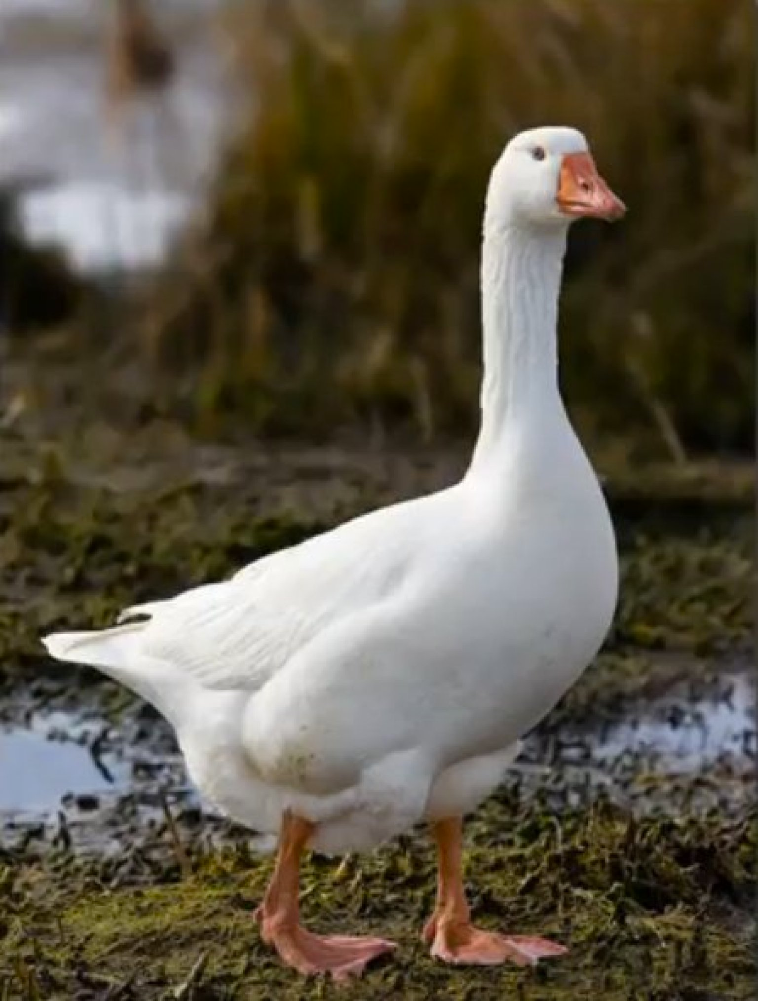
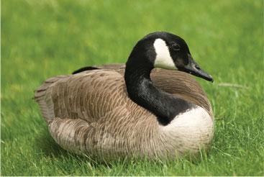
GEESE

Slide 13
GEESE
Raised in all parts of the U.S., but total around .2% of the poultry population
Farm gees are usually sold in time for the holiday market in late fall at around 5-6 months, will weigh around 11-15 pounds

Slide 14
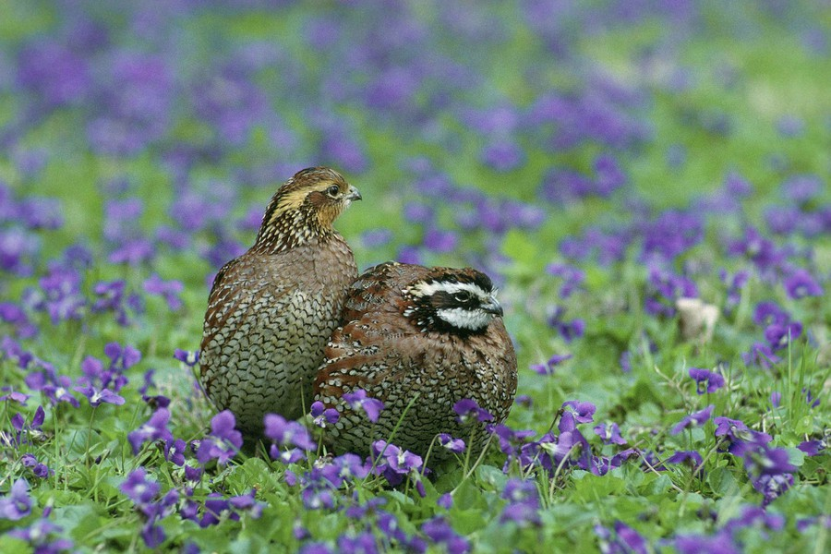
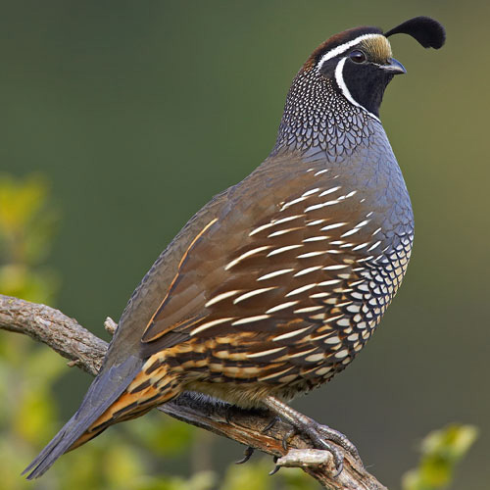
QUAIL

Slide 15
QUAIL
Game birds indigenous to the U.S.
More than 250,000 produced in the U.S. annually
Plains bobwhite, masked bobwhite, Texas bobwhite, Florida bobwhite

Slide 16
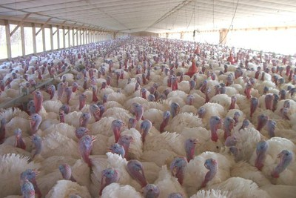
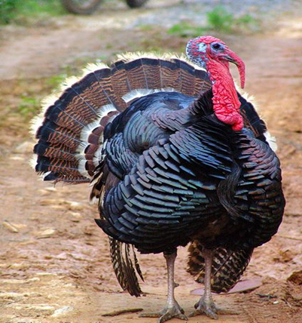
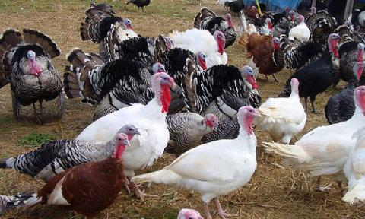
TURKEY

Slide 17
TURKEY
The modern hybrid turkeys are so large they can no longer naturally breed efficiently; practice artificial insemination
During grow-out, hens will grow to 24-30lbs and eat about 102 pounds of feed
Males will grow to 50-70 lbs and eat over 200 pounds of feed

Slide 18
REFERENCES
https://livestockconservancy.org/index.php/heritage/internal/cornish
https://livestockconservancy.org/index.php/heritage/internal/leghorn
https://livestockconservancy.org/index.php/heritage/internal/plymouthrock
https://livestockconservancy.org/index.php/heritage/internal/rired
http://www.extension.umn.edu/food/small-farms/livestock/poultry/raising-ducks/
http://extension.psu.edu/animals/poultry/topics/general-educational-material/the-chicken/modern-turkey-industry
http://extension.psu.edu/business/ag-alternatives/livestock/poultry-and-game-birds/bobwhite-quail-production
http://www.extension.umn.edu/food/small-farms/livestock/poultry/raising-geese/

