Slide 1
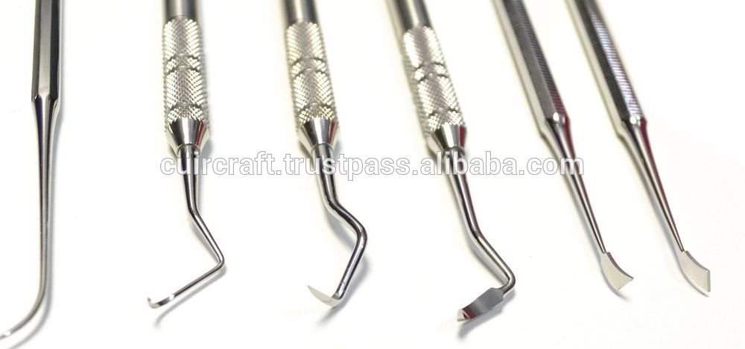
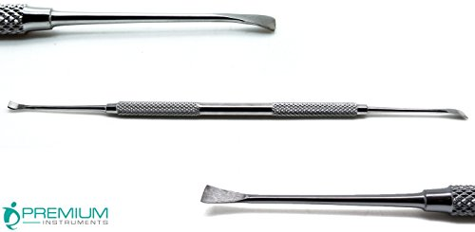
Dental scaler

Slide 2
Forceps — Babcock tissue

Slide 3
Forceps — Brown-Adson thumb

Slide 4
Small Intestines

Slide 5
Large Inestines

Slide 6
Basenji

Slide 7
Papillion

Slide 8
Brown Swiss

Slide 9
Blowfly

Slide 10
Tick- American Dog

