Slide 1
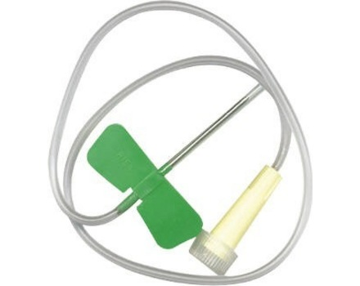
Catheter — butterfly

Slide 2
Rat tooth thumb forceps

Slide 3
Hog snare

Slide 4
Scottish Terrier

Slide 5
Yorkshire terrier

Slide 6
Percheron

Slide 7
Tapeworm Segment

Slide 8
Sucking Tick

Slide 9
Sun Conure

Slide 10
American Shorthair

